Slide 1
Break through
Bottlenecks of OVS and Virtio
by Using Smart NIC and vDPA Offload
Yi Yang @ Inspur Cloud

Slide 2
Agenda
OVS and virtio Performance Bottleneck
Solutions to Performance Bottleneck
Hardware Offload (Smart NIC and vDPA)
How to Enable SF and vDPA in Openstack
Performance Comparison
Future Work
Demonstration

Slide 3
OVS and virtio Performance Bottleneck
Kernel data path: skb not cache friendly
Virtio: memory copy, in-kernel vhost thread, ksoftirqd
Single queue/single thread does have performance celling
Multiqueue will consume too many CPU cores
It’s unacceptable for VM networking to consume precious compute resources.

Slide 4
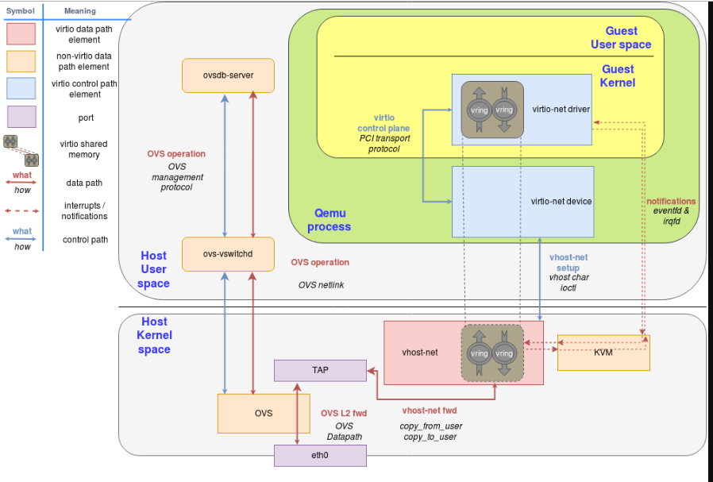
OVS and virtio Performance Bottleneck (cont’d)
memcpy copy from VM to tap port
memcpy copy to VM from tap port

Slide 5
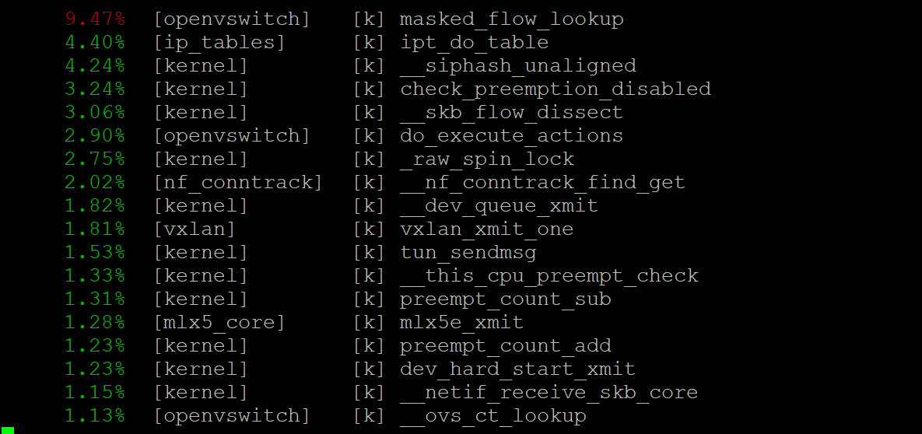
OVS and virtio Performance Bottleneck (cont’d)
send side: pert top -p <vhost-PID>

Slide 6
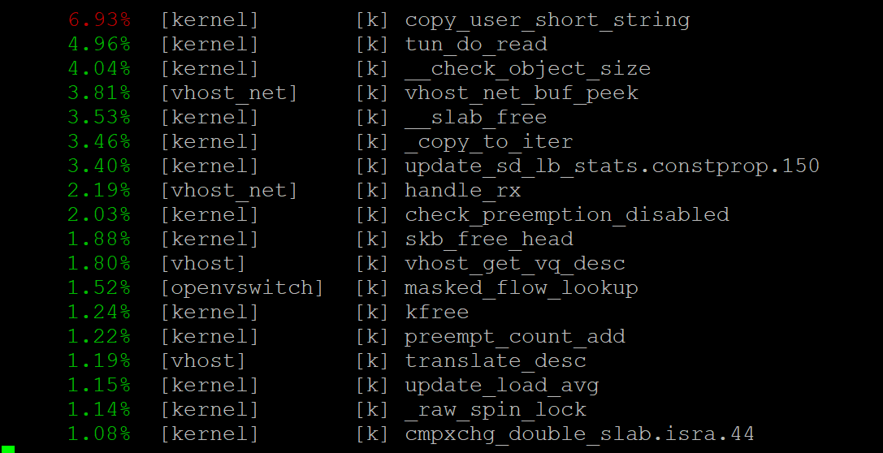
OVS and virtio Performance Bottleneck (cont’d)
receive side: pert top -p <vhost-PID>

Slide 7
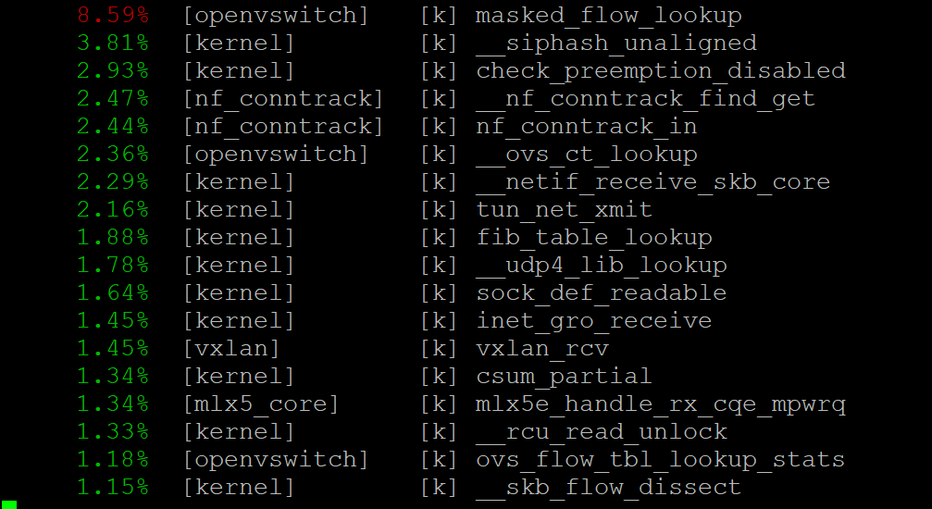
OVS and virtio Performance Bottleneck (cont’d)
receive side: pert top -p <ksoftirqd>

Slide 8
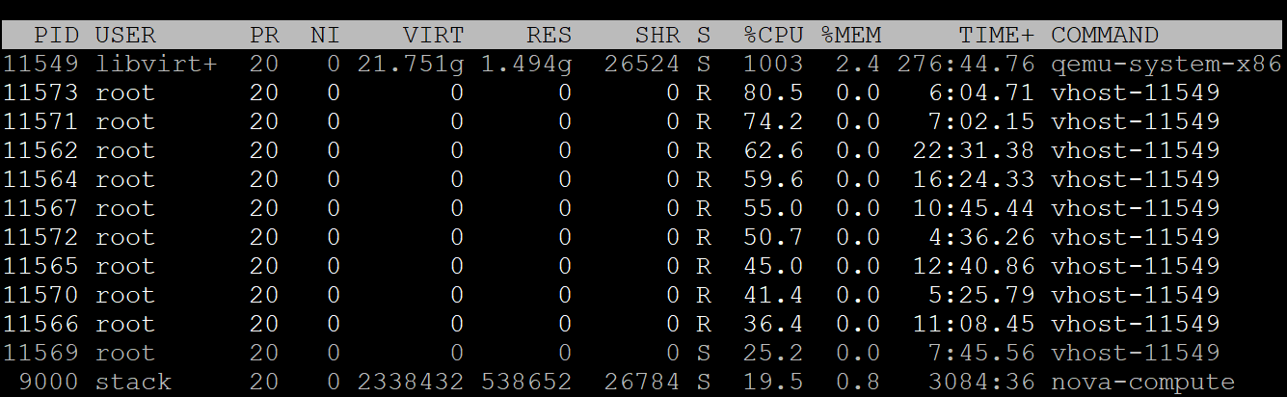
OVS and virtio Performance Bottleneck (cont’d)
send side compute node: Linux kernel pktgen with 10 Tx threads

Slide 9
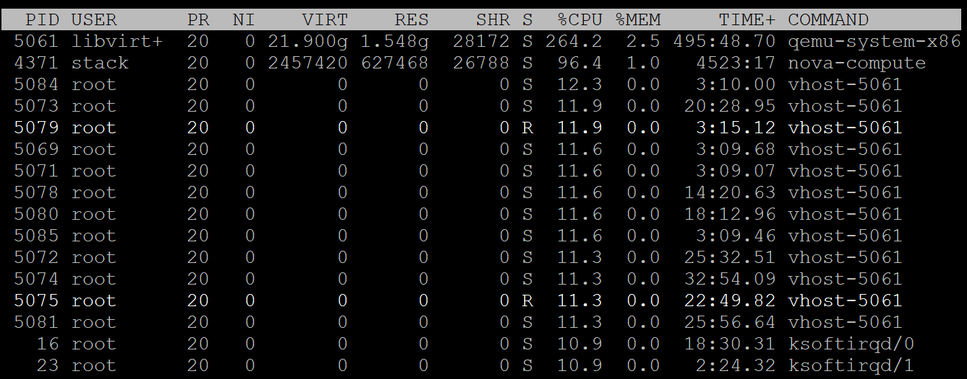
OVS and virtio Performance Bottleneck (cont’d)
receive side compute node for Linux kernel pktgen with 10 Tx threads

Slide 10
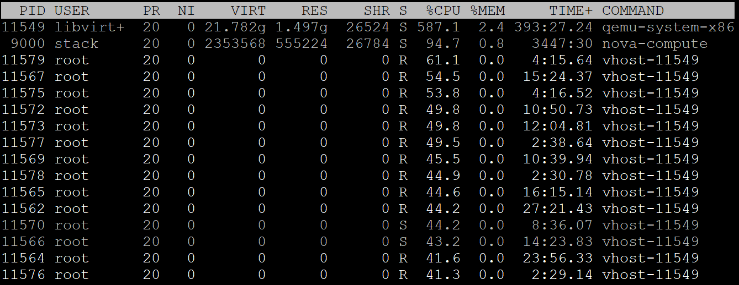
OVS and virtio Performance Bottleneck (cont’d)
send side compute node: iperf client with 16 threads

Slide 11
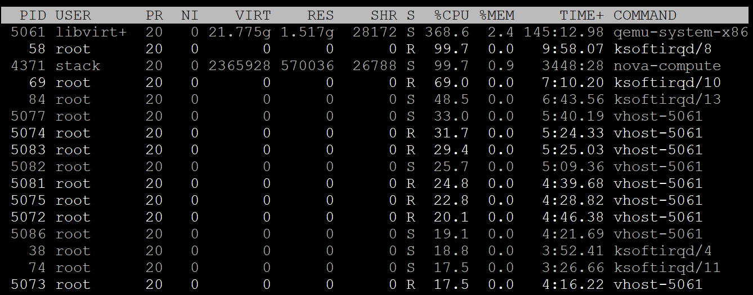
OVS and virtio Performance Bottleneck (cont’d)
receive side compute node: iperf with 16 threads

Slide 12
OVS and virtio Performance Bottleneck (cont’d)

Slide 13
Solutions to Performance Bottleneck
Solutions to Kernel datapath
  OVS DPDK
  Hardware offload (smart NIC: tc flower for kernel, rte_flow for userspace)
Solutions to virtio
  VM CPU tunning: nova config: cpu_mode = host-model | host-passthrough
  Pin vCPU: nova config: vcpu_pin_set=1-7,9-15
  Use hugepage for VM
  VM kernel parameter optimization: mitigations=off
  Tx zero copy: vhost_net module parameter, experimental_zcopytx=1
  Hardware offload: smart NIC, vDPA

Slide 14
Hardware Offload (Smart NIC and vDPA)
Smart NIC
  Offload VXLAN encap & decap
  Offload dataplane (tc datapath)
  conntrack offload (including NAT)
vDPA (virtio data path acceleration)
  Decouple control path and dat path of virtio
  Standadize VF/SF controlplane and dataplane
  Use virtio interface to achieve SR-IOV performance
  Virtio full hardware offload
  Support live migration
  Requirement: NIC driver needs a vDPA add-on

Slide 15
Hardware Offload (Smart NIC and vDPA) (cont’d)
qemu
applications
user space
virtio-net driver
virtio control plane
virtio data plane
vDPA framework
vendor specific vDPA driver
Kernel space
vendor specific control plane
VF/SF (Scalable Function): vDPA device
NIC

Slide 16
Hardware Offload (Smart NIC and vDPA) (cont’d)
SF (Scalable Function/Sub Function)
  SF is lightweigh, no full PCI config space, reset, registers
  SF is deployed one by one, but all the VFs are deployed once
  Has own capabilities and resources, e.g. rx, tx queues
  has dedicated window in PCI BAR space
  No special BIOS settings
  Can co-exist with SR-IOV
  Needn’t enable SR-IOV
  supports tc offloads
  share PCI level resources (e.g. PCI MSI-X IRQs) with other scalable functions or its parent PCI function.

Slide 17
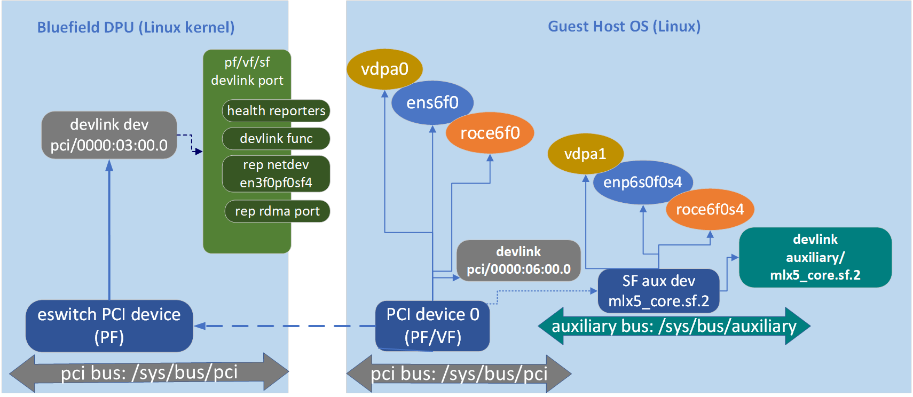
Hardware Offload (Smart NIC and vDPA) (cont’d)

Slide 18
How to Enable SF and vDPA in Openstack (cont’d)
Prerequisites:
  Linux kernel: >= 5.17
  Mellanox OFED package: >= 5.5-1.0.3.2
  Mellanox ConnextX-6 Ln | Dx | Bluefield
  qemu >= 6.2.0: --enable-vhost-vdpa
  libvirt >= 8.2.0
  iproue2-next: git://git.kernel.org/pub/scm/network/iproute2/iproute2-next.git
  neutron: needs a patch from Sean Mooney in neutron master
  neutron_lib: needs a patch from Sean Mooney in neutron_lib master
  vif_plug_ovs: needs a hacking patch to support SF
  nova: needs 8 nova patches, 7 from Sean Mooney in nova master
  Note: all the patches are https://github.com/yyang13/ovsconf-2022/

Slide 19
How to Enable SF and vDPA in Openstack (cont’d)
Install Linux kernel (>= 5.17):
  CONFIG_MLX5_ESWITCH=y, CONFIG_MLX5_SF=y, CONFIG_VDPA=m, CONFIG_MLX5_VDPA=y, CONFIG_VHOST_VDPA=m
Install Mellanox OFED package (cold reboot needed)
  https://network.nvidia.com/products/infiniband-drivers/linux/mlnx_ofed/
Enable SF (cold reboot needed)
  mlxconfig -d 0000:06:00.0 s PF_BAR2_ENABLE=0 PER_PF_NUM_SF=1 PF_TOTAL_SF=252 PF_SF_BAR_SIZE=10 SRIOV_EN=0
Add udev rules for renaming interface name:
  https://github.com/Mellanox/scalablefunctions/wiki/Upstream-step-by-step-guide#311-setup-udev-rule-file
Install iproute2-next: vdpa tool

Slide 20
How to Enable SF and vDPA in Openstack (cont’d)
Install qemu>=6.2.0, libvirt>=8.2.0
Patch Openstack Neutron, Nova, neutron_lib, vif_plug_ovs
  https://github.com/yyang13/ovsconf-2022
  Reboot neutron server, nova-api, nova-compute
Enable switchdev mode
  devlink dev eswitch set pci/0000:07:00.1 mode switchdev
Add SF:
  devlink port add pci/0000:07:00.1 flavour pcisf pfnum 1 sfnum 89
  devlink port function set pci/0000:07:00.1/98304 hw_addr fa:16:3e:9f:44:88
  ip link set dev en7f1pf1sf89 up
  devlink port function set pci/0000:07:00.1/98304 state active

Slide 21
How to Enable SF and vDPA in Openstack (cont’d)
Load vdpa modules:
  modprobe vdpa
  modprobe vhost_vdpa
  modprobe mlx5_vdpa
Unbind rdma and netdevice for SF device
  echo mlx5_core.rdma.2 > /sys/bus/auxiliary/devices/mlx5_core.sf.2/mlx5_core.rdma.2/driver/unbind
  echo mlx5_core.eth.2 > /sys/bus/auxiliary/devices/mlx5_core.sf.2/mlx5_core.eth.2/driver/unbind
Add vdpa device:
  vdpa dev add name vhost-vdpa-0 mgmtdev auxiliary/mlx5_core.sf.2 max_vqp 16

Slide 22
How to Enable SF and vDPA in Openstack (cont’d)
Openstack create vdpa port
  openstack port create --network private --host eip02 --vnic-type vdpa --mac-address fa:16:3e:9f:44:88 vdpa1
  openstack port create --network private --host eip03 --vnic-type vdpa --mac-address fa:16:3e:9f:44:89 vdpa2
Disable security group and port security
  openstack port set --no-security-group vdpa1
  openstack port set --disable-port-security vdpa1
  openstack port set --no-security-group vdpa2
  openstack port set --disable-port-security vdpa_port2
Create vDPA VM on host “eip02” and “eip03”:
  openstack server create --image ubuntu-18.04 --flavor m1.xxxlarge --port vdpa1 --availability-zone :eip02 --wait vm02-vdpa1
  openstack server create --image ubuntu-18.04 --flavor m1.xxxlarge --port vdpa2 --availability-zone :eip03 --wait vm03-vdpa2

Slide 23
Performance Comparison
AWS M5: 395,000
Alicloud: 450,000
Offload: 543,494
Number of Thread: number of Tx threads/Tx CPU cores
Nonoffload pps: no offload, other_config:hw-offload=false
Pin offload pps: offload enabled, other_config:hw-offload=true, Tx thread/Tx vCPU is pinned to physical core
offload pps: offload enabled, other_config:hw-offload=true, no cpu pin
Ideal offload pps: offload enabled, other_config:hw-offload=true， linearly scalable
Number of Thread | nonoffload pps | pin offload pps | offload pps | ideal offload pps
1 | 206466 | 456620 | 543494 | 543494
2 | 405980 | 779111 | 872120 | 1086988
3 | 598144 | 1080067 | 1268574 | 1630482
4 | 786855 | 1371746 | 1482786 | 2173976
5 | 978230 | 1485557 | 1667188 | 2717470
6 | 1165530 | 1702001 | 1867117 | 3260964
7 | 1263961 | 1908726 | 2003145 | 3804458
8 | 1264760 | 2005238 | 2077100 | 4347952
9 | 1087676 | 2088526 | 2104596 | 4891446
10 | 1018677 | 2085864 | 2115143 | 5434940

Slide 24
Performance Comparison (cont’d)

Slide 25
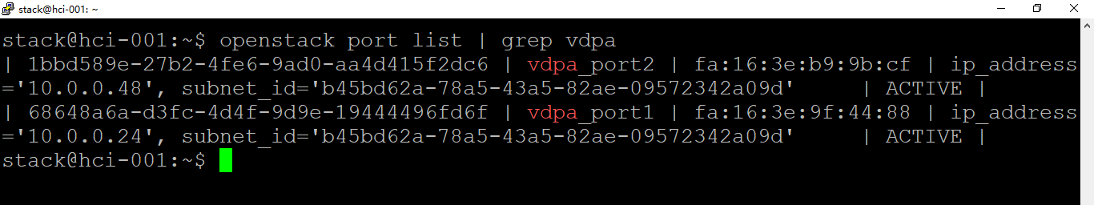
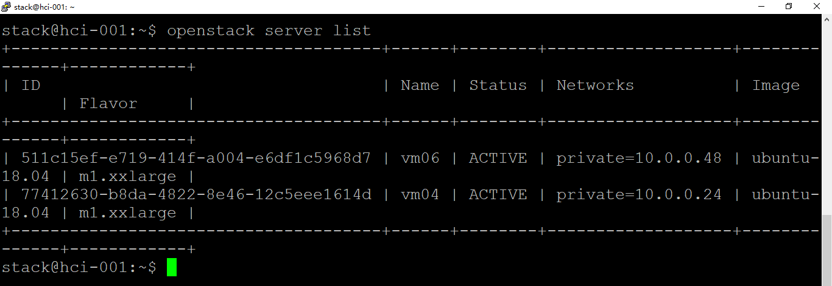
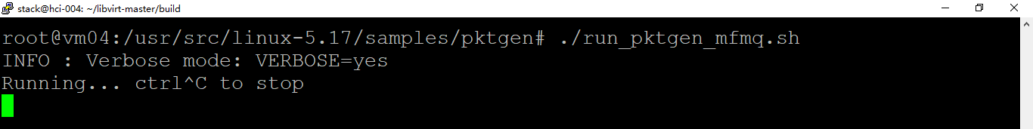

Slide 26
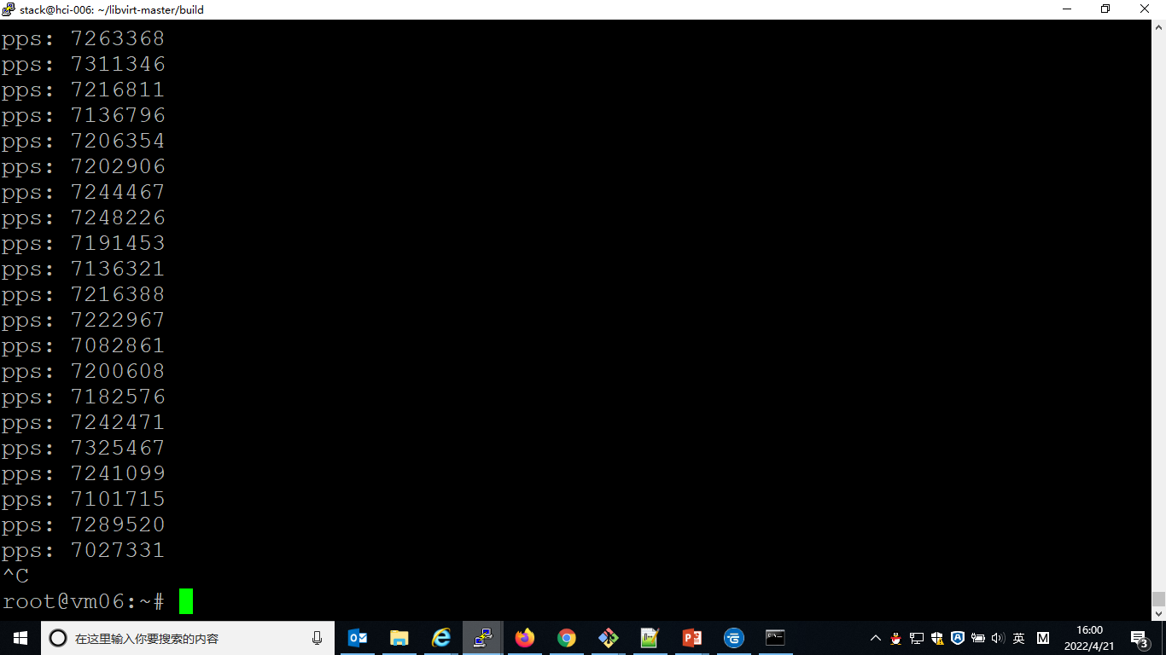

Slide 27
Future Work
Verify live migration
Investigate and fix conntrack offload issues
Support Katacontainer (both VM and container use Openstack neutron virtual network)
Roll out in production environment

Slide 28
Demo
https://github.com/yyang13/ovsconf-2022/blob/main/2022-10-25-15-22-11.mp4?raw=true
https://github.com/yyang13/ovsconf-2022/blob/main/2022-10-26-15-06-14.mp4?raw=true

Slide 29
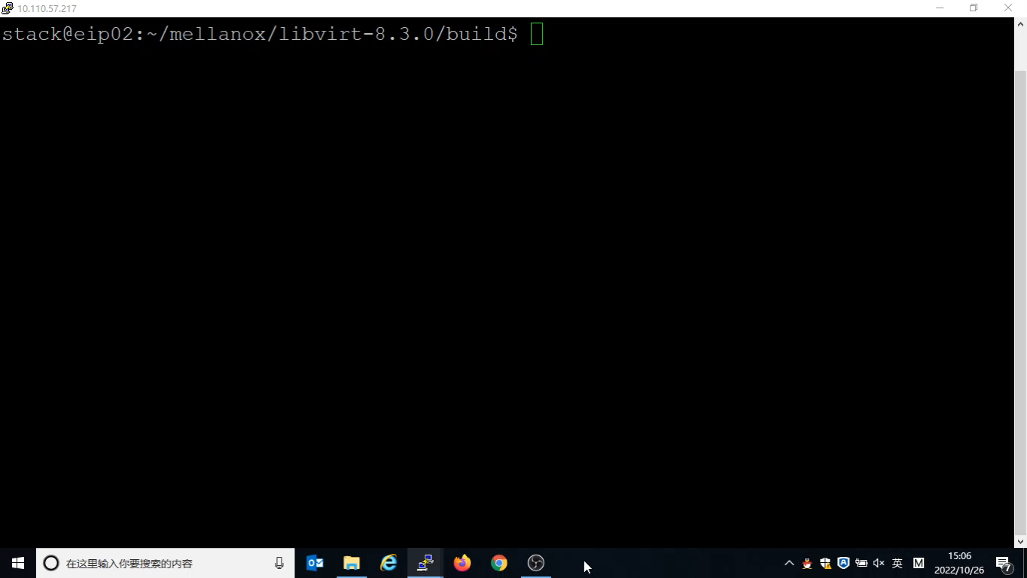

Slide 30

Thank you!!!

