Slide 1
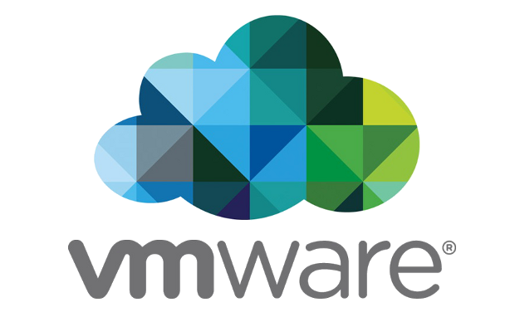
OVS-DPDK on Windows
William Tu, Vmware
OVS Conference 2021
tuc@vmware.com
Notes:
RFC patch: https://mail.openvswitch.org/pipermail/ovs-dev/2021-November/389119.html

Slide 2

Open vSwitch and its Datapaths
A software switch like Linux bridge / Hyper-V switch
SDN Controller
OpenFlow
ovs-vswitchd
OVS Datapath:
A packet I/O channel
A cache of processing results from OpenFlow tables
Key to end-to-end performance
Slow Path
Fast Path
Datapath
packet I/O channel

Slide 3



Datapath Implementations
Linux kernel: openvswitch.ko^{[1]}
Windows kernel module: hyper-v extension^{[2]}
Userspace datapath: part of ovs-vswitchd, used by DPDK or AF_XDP
[1] https://dl.acm.org/doi/10.1145/3452296.3472914
[2] https://docs.openvswitch.org/en/latest/topics/windows/

Slide 4

Userspace Datapath with DPDK
SDN Controller
Also called OVS-DPDK
Fast due to kernel by-pass
Usually for appliance with dedicated HW
Work on Linux only
ovs-vswitchd
Userspace Datapath
Userspace
DPDK library
Hardware

Slide 5
Benefits of OVS-DPDK on Windows/Linux
Flexibility & Maintainability
Share most of the datapath code, using the same configuration tools
New datapath features can be added cross-platform
Bugs can be fixed easier than in kernel module
Performance
DPDK packet I/O is way faster than kernel
Userspace datapath has more optimizations
Flow offload interface using rte_flow API / tc-flower
Code / Bug Fixes
Userspace datapath
Flow Processing
packet I/O
Flow offload

Slide 6

Implementations
Build System
Add windows support for Meson^{[1]} (See Sergey’s talk)
Features that need port/replace to Windows
POSIX open_memstream, fopencookies are used to redirect DPDK logs
vhostuser protocol to connect VM/container
dpdk-socket-mem configuration
Detecting numa node and numa information
Detecting system/cpu/memory info from /proc
RFC patch: https://mail.openvswitch.org/pipermail/ovs-dev/2021-November/389119.html
[1] http://patchwork.ozlabs.org/project/openvswitch/cover/20210808014931.320242-1-sergey.madaminov@gmail.com/
Notes:
RFC patch: https://mail.openvswitch.org/pipermail/ovs-dev/2021-November/389119.html
[1] http://patchwork.ozlabs.org/project/openvswitch/cover/20210808014931.320242-1-sergey.madaminov@gmail.com/

Slide 7
Compile and Link using Meson
Meson build for DPDK
autotools for OVS and link with DPDK
Support multiple compilers
Meson build for both DPDK and OVS
Support only clang compiler
Build Linux-DPDK
$ export DPDK_BUILD=$DPDK_DIR/build
$ meson build && ninja -C build
Build OVS with DPDK
$ ./configure --with-dpdk=static
$ make
Build Windows-DPDK
$ meson build
Build OVS with DPDK
$ meson build -Dwith-pthread=C:\PTHREADS-BUILT \ -Dwith-dpdk=C:\dpdk\
$ ninja -C build
https://doc.dpdk.org/guides/windows_gsg/

Slide 8
Run OVS-DPDK: PMD support
OVS relies on DPDK PMD driver for packet I/O
Not all of the DPDK pmd drivers are ported to Windows
PMD support:
Physical Device: ice, i40e, mlx5, ixgbe
Virtual Function: ixgbevf, mlx5, ice
Virtual Device: e1000, vmxnet3
Host Configurations
Mellanox: DevX and WINOF2^{[1]}
Intel and others: netuio and virt2phys^{[2]}
Demo DPDK using e1000/vmxnet3^{[3]}
OVS Userspace Datapath
DPDK PMD
[1] https://doc.dpdk.org/guides/nics/mlx5.html
[2] https://doc.dpdk.org/guides/windows_gsg/run_apps.html
[3] https://www.youtube.com/watch?v=Ew_g4e5sUJ0, https://www.youtube.com/watch?v=UZ9hm2jQa2Y

Slide 9
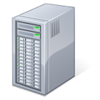
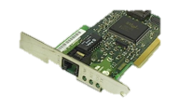
Testbed and Configuration
12-core Intel Xeon
E5 2650 2.4GHz
32GB memory
DPDK packet generator
Mellanox ConnectX-6 Dx
Dual port 25G NIC
Installed DevX and WINOF2
Datapath Performance Comparison
Kernel: The OVS Windows kernel module
DPDK L2FWD: The example program from DPDK
XDP_TX^{[1]}: The reflect_packet.o from ebpf-for-windows project
rte_flow offload: Process flow entirely in hardware
[1] https://github.com/microsoft/ebpf-for-windows/issues

Slide 10
Start OVS-DPDK (1/2)
ovsdb and ovs-vswitchd
$ ovs-vsctl --no-wait set Open_vSwitch . \
other_config:dpdk-init=true
$ ovs-vsctl set Open_vSwitch . \
other_config:hw-offload=true
$ ovs-vswitchd.exe --pidfile -vfile:info --log-file --disable-system \
--dummy-numa=”0,0,0,0,0,0,0,0,0,0,0,0”
Create bridge and port
$ ovs-vsctl add-br br0 --set Bridge br0 datapath_type=netdev \
other_config:pmd-cpu-mask=0xfff
$ ovs-vsctl add-port br0 p0 -- set int p0 type=dpdk \
options:dpdk-devargs=0000:02:00.0

Slide 11
Start OVS-DPDK (2/2)
Add OpenFlow rules
rxdrop
$ ovs-ofctl add-flows br0 "in_port=p0, actions=drop"
l2fwd
$ ovs-ofctl add-flows br0 "in_port=p0, actions=output:p1"
Start traffic-gen
$ ./dpdk-testpmd -a 0000:02:00.0 -- -i --port-topology=chained \
--forward-mode=txonly --eth-peer=0,1C:34:DA:64:3B:A8

Slide 12
OVS-DPDK on Windows Performance
XDP_TX: using reflect_packet.o from ebpf-for-windows project
rte_flow offload: Need action: DROP, COUNT, and PORT_ID support
Notes:
See 12.2.8
https://doc.dpdk.org/guides/prog_guide/rte_flow.html
Ebpf-for-windows project
https://github.com/microsoft/ebpf-for-windows/issues/639

Slide 13
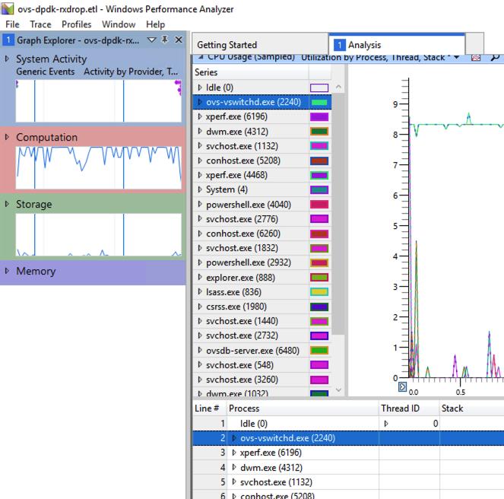
Performance Analysis
Using Windows Performance Toolkit:
PS> Start OVS
PS> xperf -start –on
DiagEasy+Profile –stackwalk
profile
PS> xperf -stop -d c:\trace.etl
PS> Stop OVS
Compare
OVS kernel
OVS-DPDK
https://docs.microsoft.com/en-us/windows-hardware/test/wpt/windows-performance-analyzer

Slide 14
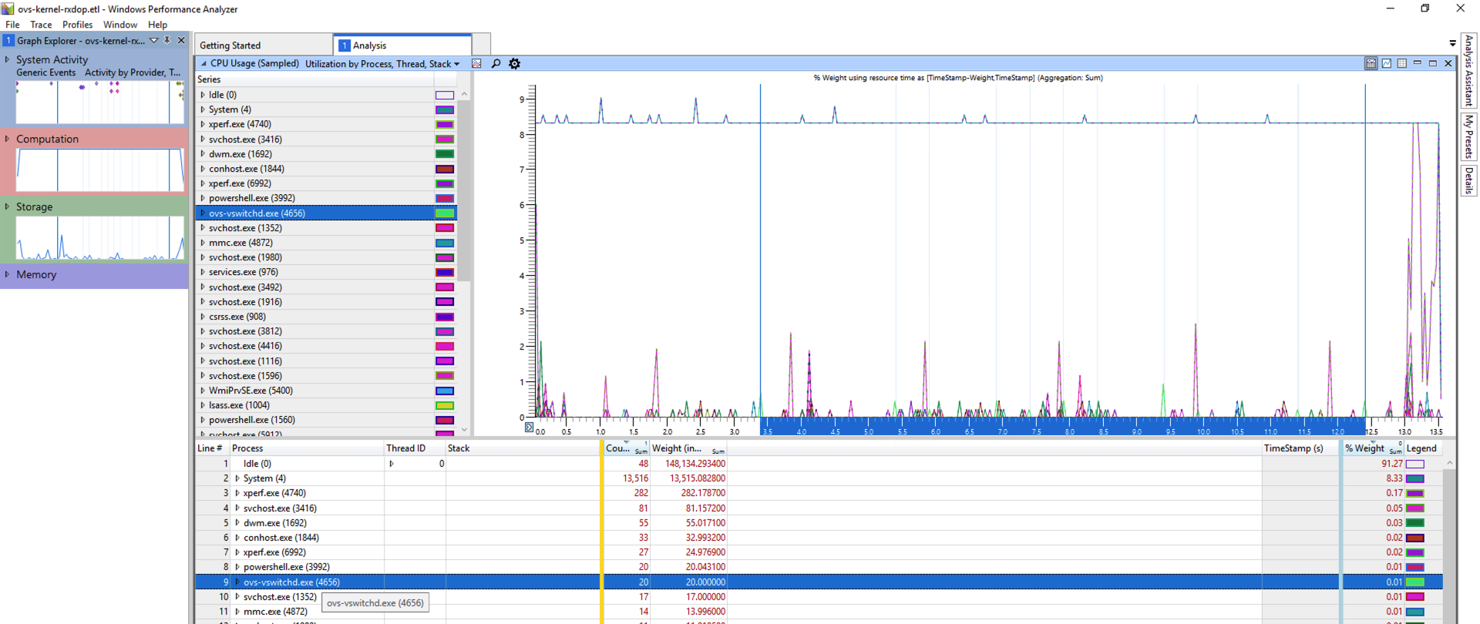
OVS Kernel Module
CPU Utilization
Not OVS?
The system has 12 cores, 100% / 12 = 8.33
ovs-vswitchd.exe
Only 0.01

Slide 15
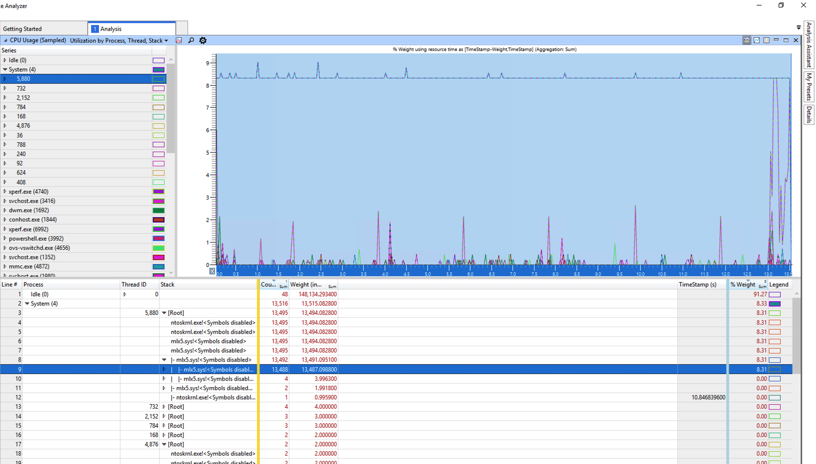
OVS Kernel Module
Kernel module
mlx5 kernel driver

Slide 16
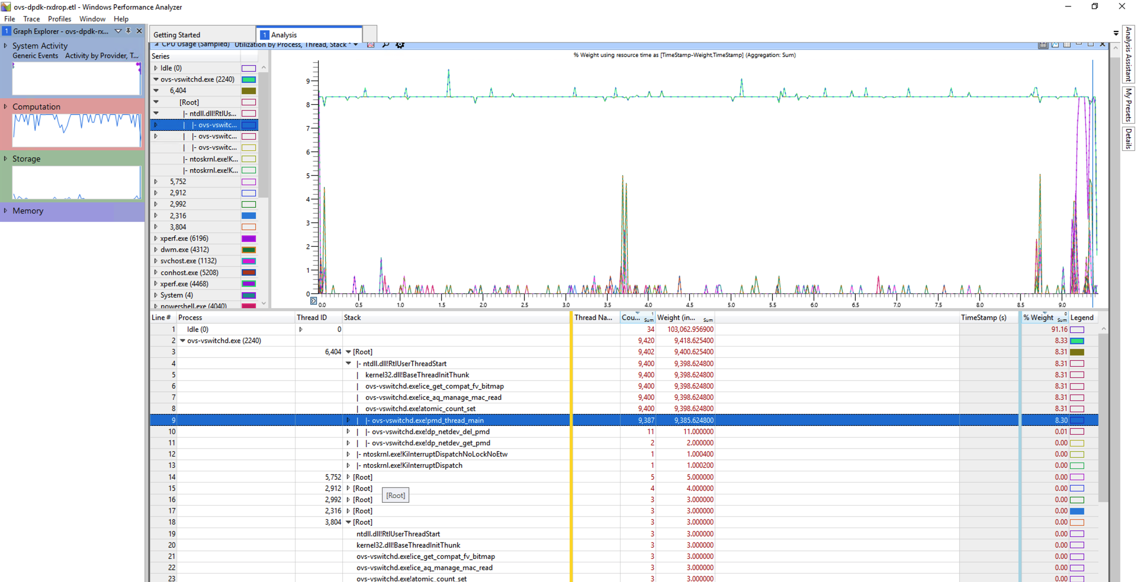
OVS-DPDK
OVS PMD thread
ovs-vswitchd.exe
OVS PMD thread

Slide 17
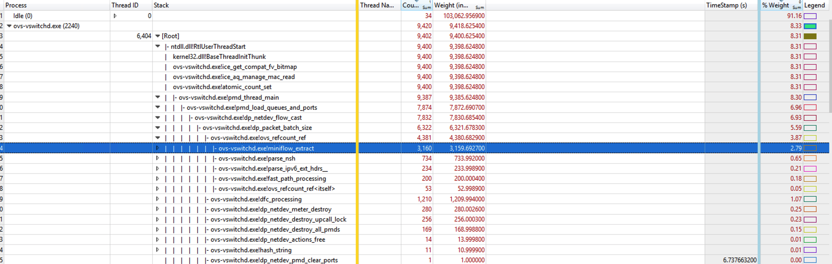
OVS-DPDK
Call stack of ovs pmd thread

Slide 18
Conclusion and Future Work (1/2)
Write once, run everywhere?
DPDK library as an abstraction layer for device driver
Need to test all existing datapath features on both platforms
OVS-DPDK shows x10 better performance than kernel
But that’s packet forwarding, what if we need tcp/ip stack?
CPU utilization is high, interrupt-mode support is WIP
HW offload: show high performance with low CPU

Slide 19
Conclusion and Future Work (2/2)
Interface to connect to VM or Container (WIP)
Windows AF_XDP support for Windows
Containers Connect through Windows Host vNIC PMD
Deploy OVS-DPDK on the Cloud
Azure: mlx5 VF, AF_XDP
Amazon EC2: ixgbevf, ena
Google cloud: virtio

Slide 20
Thank you
And try it out:
https://mail.openvswitch.org/pipermail/ovs-dev/2021-November/389119.html

Slide 21
Backup Slides

Slide 22
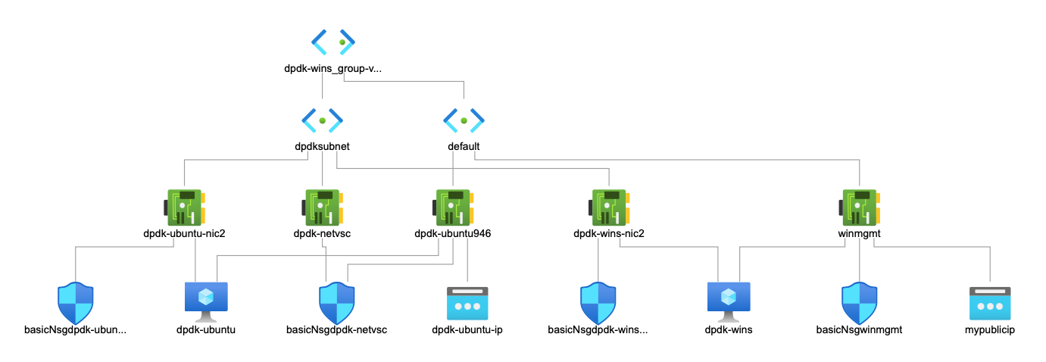
Configuration and Topology on Azure
Standard D2sv3 VM with ConnectX-4
dpdk-ubuntu runs Linux as pkt-gen, dpdk-wins runs Windows OVS-DPDK
Each VM has two interfaces: one for mgmt (netvsc) . and one for DPDK (mlx5), each has its own subnet

Slide 23
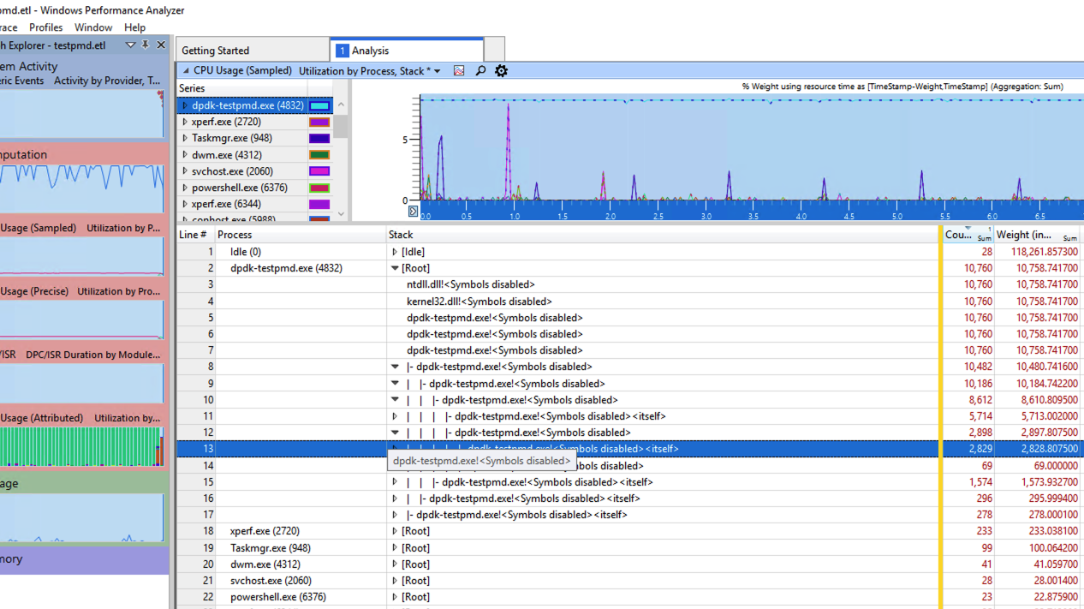

Slide 24
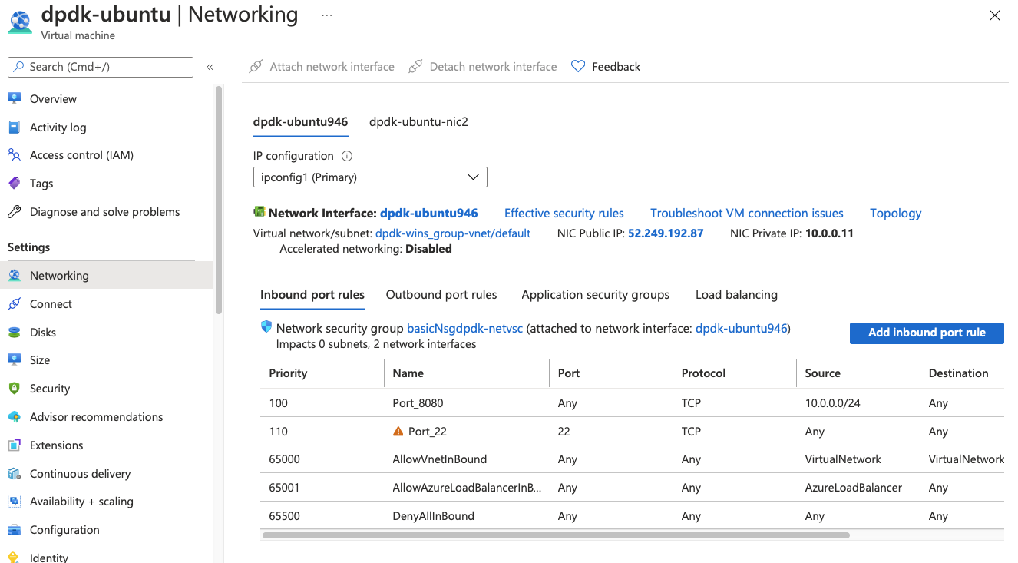

Slide 25
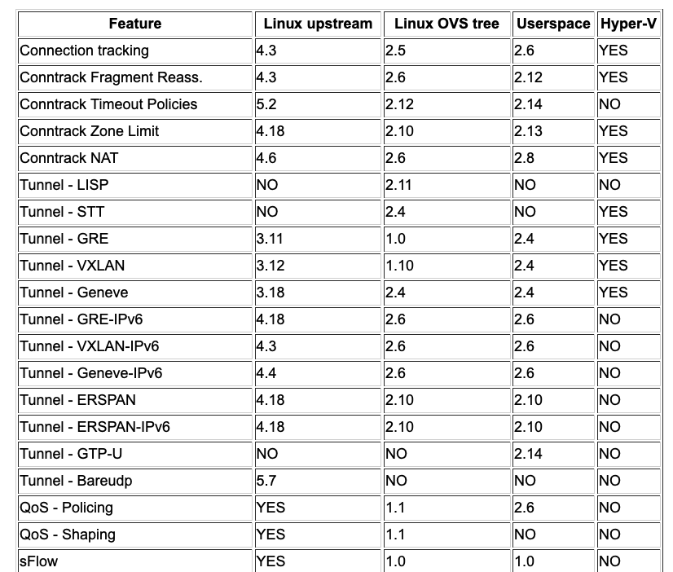
Datapath Features Mismatch
Q: Are all features available
with all datapaths?
https://docs.openvswitch.org/en/latest/faq/releases/

Slide 26
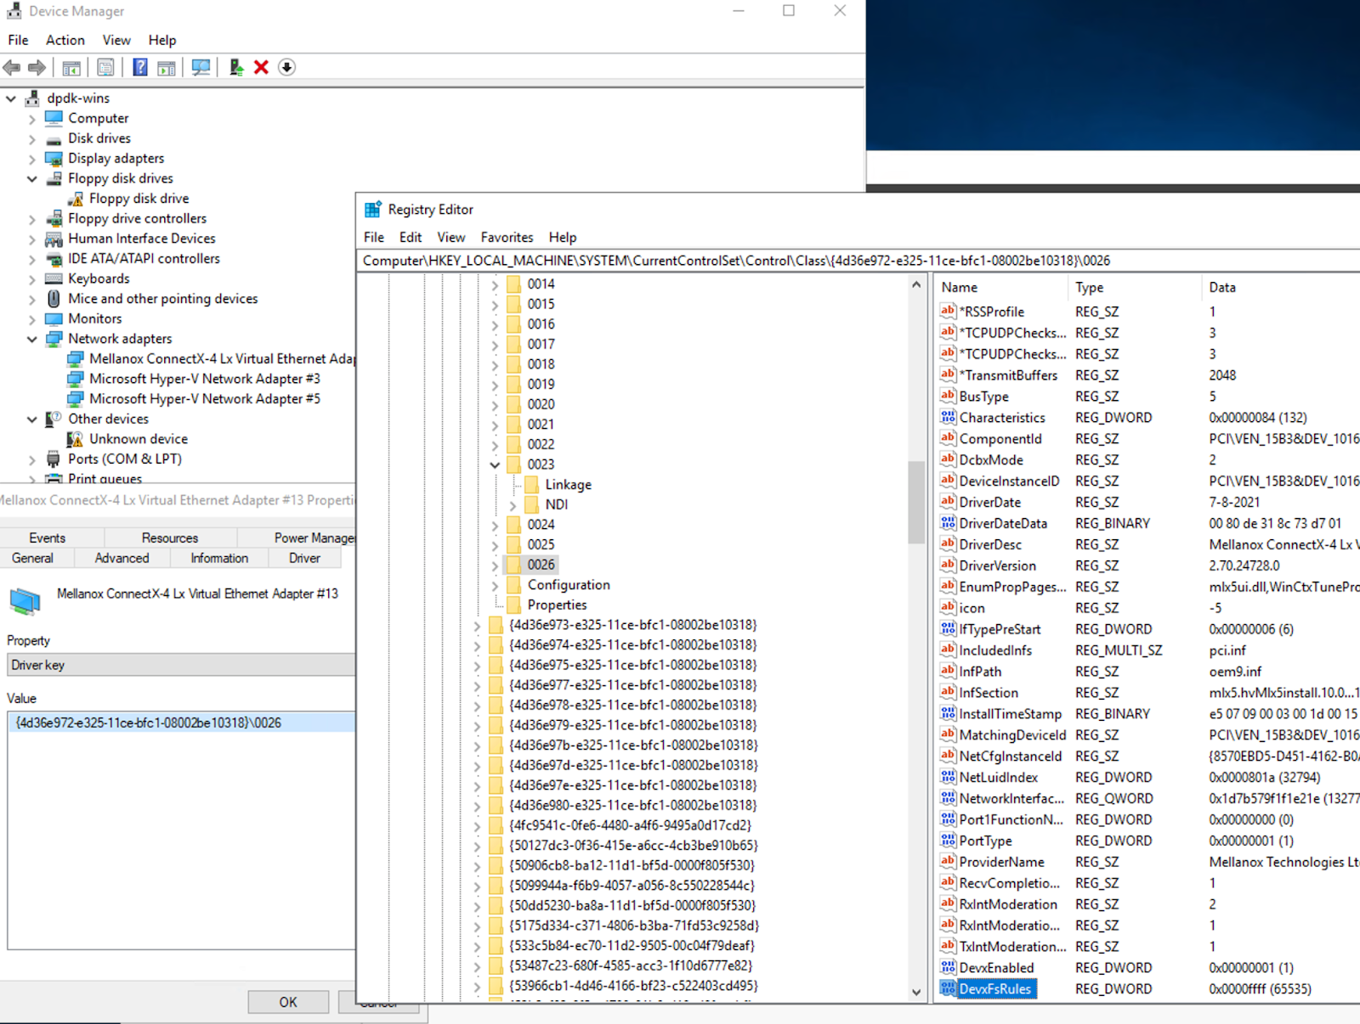

Slide 27
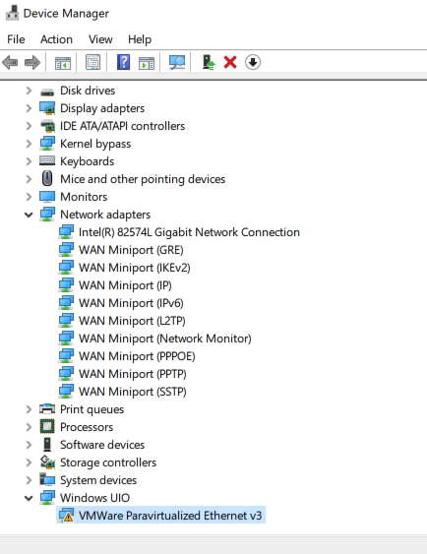
Assign netuio and load l2fwd.exe
EAL: PCI device 0000:1b:00.0 on NUMA socket 0 EAL: probe driver: 15ad:7b0 net_vmxnet3 EAL: Requested device 0000:1b:00.0 cannot be used MAC updating enabled EAL: Error - exiting with code: 1 Cause: No Ethernet ports - bye PS C:\dpdk\build2\examples>
Video: https://youtu.be/ipMG1eCoe6I

