Slide 1
OVN Performance
Past, Present, and Future
Mark Michelson
Senior Software Developer
Red Hat
mmichels@redhat.com

Slide 2
Before we start
All test cases run using OVS sandbox on a laptop
Individual numbers are unimportant
The CHANGE is very important
DO NOT take any numbers in this presentation as gospel!

Slide 3
Past Improvements

Slide 4
ovn-nbctl daemonization
Test Case (based on OpenShift estimates):
1 Logical router
159 Logical switches connected to the logical router
92 Logical switch ports on each logical switch
Every 2 logical switch ports belongs to a new address set
Every port gets 2 ACLs created for it
14628 logical switch ports
7314 address sets
29256 ACLs
73460 calls to ovn-nbctl (5 per logical switch port)
Number of hypervisors is unimportant

Slide 5
ovn-nbctl daemonization (cont.)
$ time ./scale.sh
real 759m27.270s
user 500m40.805s
sys 36m5.682s
That’s 12 hours 39 minutes 27 seconds

Slide 6
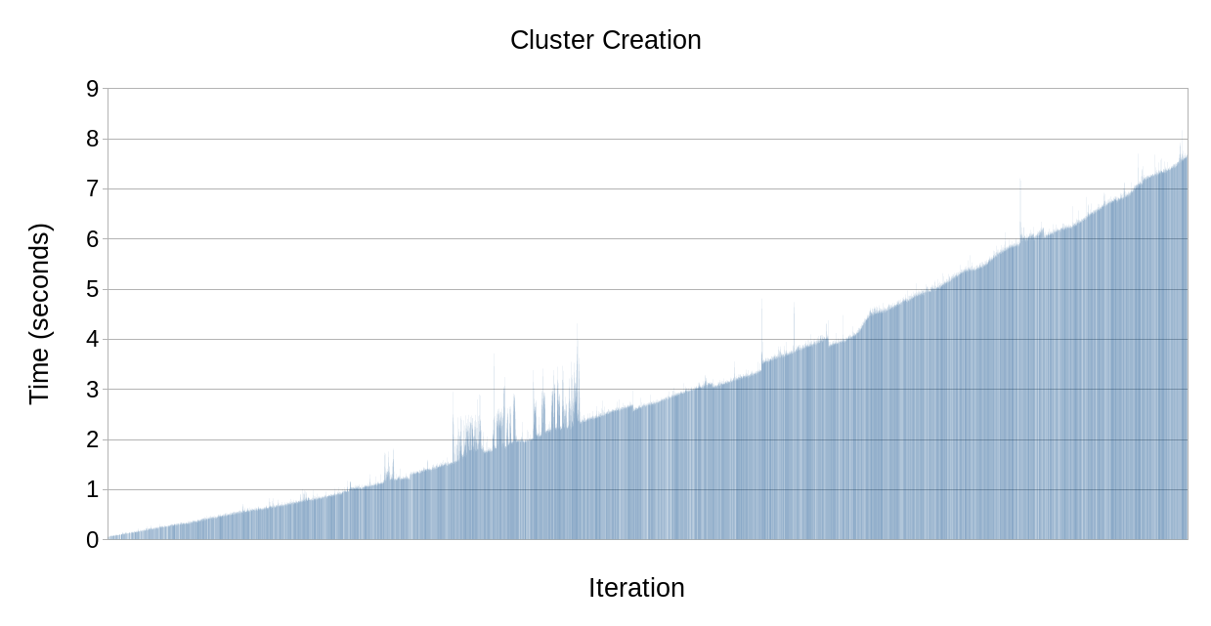
ovn-nbctl daemonization (cont.)

Slide 7
ovn-nbctl daemonization (cont.)
ovn-nbctl downloads entire northbound database on every invocation
As database grows, ovn-nbctl gets slower
Solution: use an ovsdb client daemon process, and have ovn-nbctl connect to that
$ export OVN_NB_DAEMON=$(ovn-nbctl --pidfile --detach)

Slide 8
ovn-nbctl daemonization (cont.)
$ time ./scale-daemon-new.sh
real 5m9.950s
user 1m18.702s
sys 1m41.979s
That’s 0.007% of the previous test (!!)

Slide 9
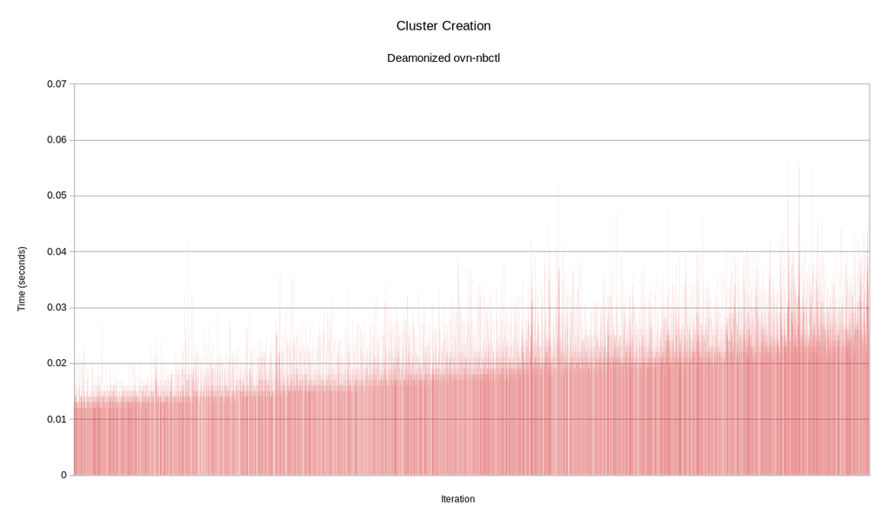

Slide 10
Port Groups
Test Case (based on exaggerated OpenStack ACL scenario):
1 Address set with 1020 IP adddresses
1 logical switch with 1000 logical switch ports
Creation of logical switch port has --wait=hv
Each logical switch port is bound to the br-int OVS bridge
1 ACL per logical switch port. The ACL references the address set.
Test is run in the ovs-sandbox, so there is 1 hypervisor

Slide 11
Port Groups (cont.)
$ time ./load_net.sh 1000
real 125m16.022s
user 2m47.103s
sys 0m11.376s
That’s 2 hours, 5 minutes, and 16 seconds

Slide 12
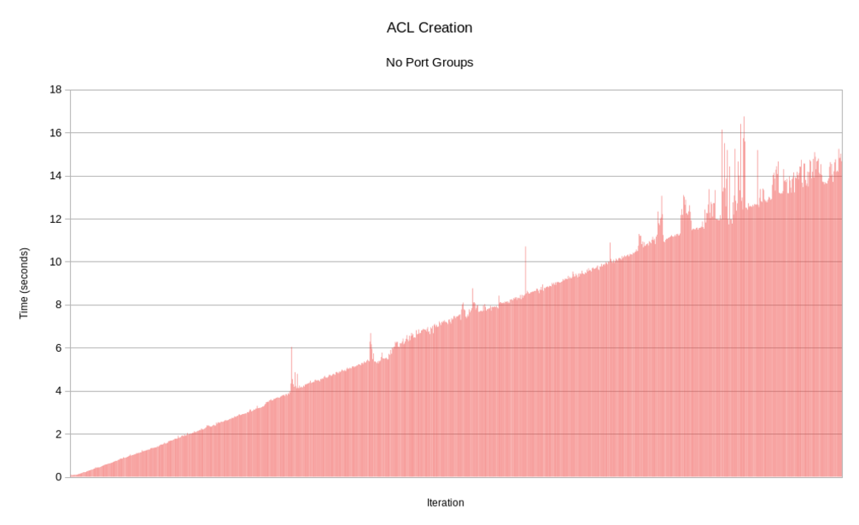

Slide 13
Port Groups (cont.)
$ ovs-ofctl dump-flows br-int | wc -l
1033699
$ ovs-ofctl dump-flows br-int | grep table=44 | wc -l
1025001
ACL flows account for 99.2% of the total
Number of ACL flows is O(P X n(AS) ) where
P is number of ports
n(AS) is number of elements in address set

Slide 14
Port Groups (cont.)
Problem:
Expression parser cannot generate conjunctive match for common ACL scenario
Solution:
Allow for easy consolidation of ACLs using Port Groups

Slide 15
Port Groups (cont.)
$ time ./load_net_pg.sh 1000
real 6m23.696s
user 3m15.920s
sys 0m10.849s
That’s 4.8% of the time the original version took

Slide 16
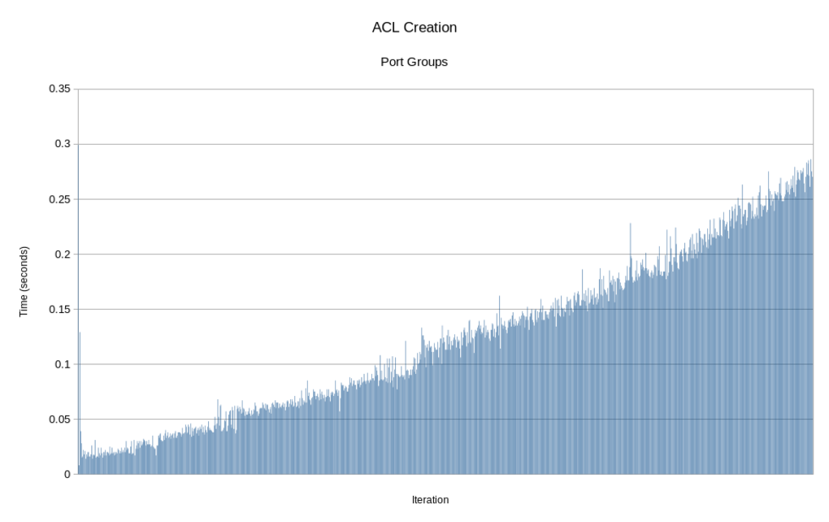

Slide 17
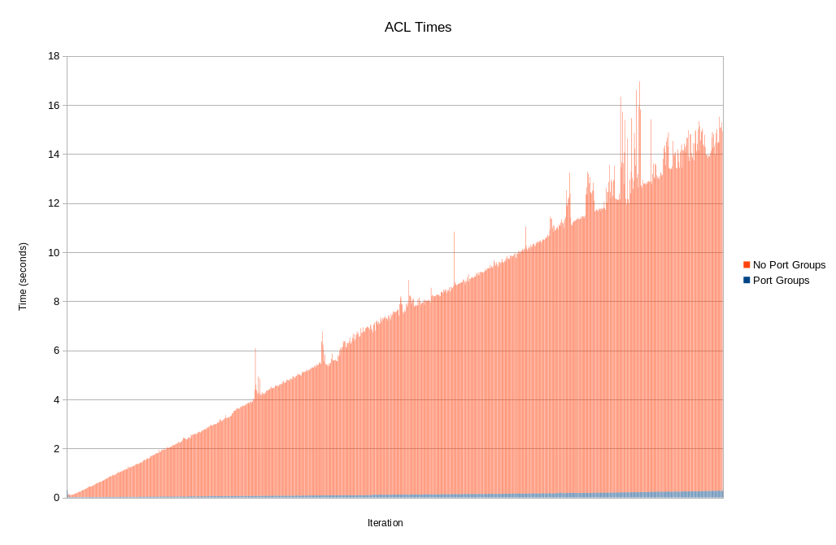

Slide 18
Port Groups (cont.)
$ ovs-ofctl dump-flows br-int | wc -l
9098
$ ovs-ofctl dump-flows br-int | table=44 | wc -l
2027
Total flows are 0.009% of the previous test
ACL-related flows account for 22.3% of total
Number of ACL flows is O(P + n(AS)) now

Slide 19
Future Improvements

Slide 20
Incremental Processing
Problem:
ovn-northd always processes the entire northbound database in each loop iteration
ovn-controller always processes the entire southbound database in each loop iteration
This can be wasteful when databases do not change much
Recall how this affected ACL flow processing previously

Slide 21
Incremental Processing (cont.)
Solution:
Incremental Processing
Only process changes to data, rather than the entire dataset

Slide 22
Incremental Processing (cont.)
Secondary Problem:
Incremental processing is HARD
An imperative language like C is not natural for expressing dependencies between entities.
Solution:
Differential Datalog!
Incremental database transformation language
Haskell-implemented language for expressing data transformation/dependencies
Outputs Rust

Slide 23
Further future improvements
Note: All of these come straight from my head onto the slide. None are being worked on or have even been discussed
Incremental flow calculation in ovn-controller
Pass deltas directly from ovn-northd to ovn-controller
Maybe just “compress” the Logical_Flow southbound table
Generate conjunctive matches from disparate logical flows
Perform logical flow expression parsing at a more central level

Slide 24
THANK YOU
plus.google.com/+RedHat
facebook.com/redhatinc
linkedin.com/company/red-hat
twitter.com/RedHatNews
youtube.com/user/RedHatVideos

