Slide 1








The Discrepancy of the Megaflow Cache in OVS
Levente Csikor Gábor Rétvári
Stefan Schmid (University of Vienna)
Dimitrios P. Pezaros (University of Glasgow)
Christian Esteve Rothenberg (University of Campinas)

Slide 2
Main aims of Open vSwitch
Meet the needs of the community
  feature-rich OpenFlow switch
  to manage network(s) of VMs
Due to its evolution OVS became
  de-facto standard of OpenFlow software switch
  most popular back-end in OpenStack
  started to captivate serverless environments (e.g., Kubernetes)
Reasons for success:
  catching up with industrial needs
    Fast w/o sacrificing high programmability and generality
Notes:
Meet the needs of the open source networking community
feature rich OF switch offering a sophisticated way

Slide 3
Fast…but HOW?
Slow Path – Fast Path Separation
Flow Table
ip_src | action
10.0.0.0/8 | output:1
* | drop
Flow table
  ordered set of wildcard rules
  operating on a set of header fields
  set of packet processing primitives to be applied
  flow rules can overlap (priorities)!
Fastening packet classification
  First packet is subjected to full-blown flow table processing
  Subsequent packets
    flow-specific rules and actions are cached in the fast path
ovs-vswitchd
slow path
user
fast path
kernel
OVS Kernel module
Notes:
How did OVS achieved to be fast and preserve its advantages? Slow path – fast path separartion
OVERLAPING RULES: for increased flexibility, flow rules can overlap, however this makes packet classification rather complex since, even in the case of non-overlapping flow rules, the complexity of any wildcard matching rule matching algorithm coulb be exponential

Slide 4
Fast path – Flow caches
Flow Table – SLOW PATH
ip_src | action
10.0.0.0/8 | output:1
* | drop
MATCH
MATCH
cache miss
cache update
MegaFlow Cache (MFC)
ip_src=10.0.0.0/8,ip_dst=*,sport=*,dport=*, *** ➔ output: 1
ip_src=1.0.0.0/8,ip_dst=*,sport=*,dport=*, *** ➔ drop
Packet
eth_type=0x800
ip_src=10.0.0.3
ip_dst=8.8.8.8
sport=12345
dport=53
Packet
eth_type=0x800
ip_src=10.0.0.1
ip_dst=10.0.0.2
sport=12345
dport=80
Packet
eth_type=0x800
ip_src=1.2.3.4
ip_dst=10.0.0.2
sport=12341
dport=80
cache miss
cache hit/update
Exact Match Cache (EMC)
ip,ip_src=10.0.0.1,ip_dst=10.0.0.2,sport=12345,dport=80,… ➔ output: 1
ip,ip_src=10.0.0.3,ip_dst=8.8.8.8,sport=42345,dport=53,… ➔ output: 1
ip,ip_src=1.2.3.4,ip_dst=10.0.0.2,sport=12341,dport=80,… ➔ drop
packet in
packet out
Notes:
the microflow cache implements a per-transport-connection exact-match store over all header fields;
the megaflow cache (MF) , which, by introducing arbitrary bitwise wildcarding to the kernel space, has enabled the biggest performance improvement so far

Slide 5
Deeper insight into the MFC
Data structure is based on tuple-space search (TSS)
  entries matching on the same header fields are collected into a hash
    masked packet headers can be found fast
To reduce complexity, slow-path makes MFC entries non-overlapping
  masks and associated hashes are searched sequentially
  until the first matching entry is found
  Can be a costly linear search in case of lots of masks!
Notes:
Let’s get our hands dirty, and see how the megaflow cache itself is built and managed

Slide 6
Deeper insight into the MFC (ACL example)
even one simple flow rule on
3 bits can spawn 3 masks and 4 MFC entries in total!
hypothetical 3-bit protocol
2 overlapping flow-rule
MFC needs to distinguish among all possible packets on 3-bit protocol
having exact match would not be effective (➔ EMC)
let’s wildcard some bits ➔ (key,mask) pairs
MFC entries are NON-OVERLAPPING
Flow Table
hyp.proto | action
000 | output:1
* | drop
1*0
110
111
100
101
1*1
010
MegaFlow Cache
(KEY, MASK) ➔ ACTION
(000,111) ➔ output:1
(0*1,101) ➔ drop
(010,111) ➔ drop
(1**,100) ➔ drop
010
011
000
001
0*1
exact match on the allow-rule
cover the rest
Note: more than one solution exist (more masks as well)
Notes:
once we send all these packets (i.e., covering the whole 3-bit protocol range = 8 packets),
more than one solution -> heuristical algorithm on finding an optimal mapping

Slide 7
Deeper insight into the MFC (ACL example)
hypothetical 3-bit protocol
2 overlapping flow rules
MFC needs to distinguish among all possible packets on the 3-bit prot.
having exact match would not be effective (➔ EMC)
let’s wildcard some bits ➔ (key, mask) pairs
MFC entries are NON-OVERLAPPING
Flow Table
hyp.proto | action
000 | output:1
* | drop
110
111
100
101
MegaFlow Cache
(KEY, MASK) ➔ ACTION
(000,111) ➔ output:1
(0*1,101) ➔ drop
(010,111) ➔ drop
(1*0,101) ➔ drop
(1*1,101) ➔ drop
010
011
000
001
(1**, 100) ➔ drop
exact match on the allow-rule
cover the rest
Note: more than one solution exist
OVS tries to wildcard most of the bits
Notes:
once we send all these packets (i.e., covering the whole 3-bit protocol range = 8 packets),
more than one solution -> heuristical algorithm on finding an optimal mapping

Slide 8


Theorem
Comments from classifier.h
* Some properties of the wildcard mask:
*
* - "False 1-bits" are acceptable, that is, setting a bit in the wildcard
* mask to 1 will never cause a packet to be forwarded the wrong way.
* As a corollary, a wildcard mask composed of all 1-bits will always
* yield correct (but often needlessly inefficient) behavior.
*
* - "False 0-bits" can cause problems, so they must be avoided. In the
* extreme case, a mask of all 0-bits is only correct if the classifier
* contains only a single flow that matches all packets.
*
* - 0-bits are desirable because they allow the datapath to act more
* autonomously, relying less on ovs-vswitchd to process flow setups,
* thereby improving performance.
*
* - We don't know a good way to generate wildcard masks with the maximum
* (correct) number of 0-bits. We use various approximations…
Given an ACL on a w-bit header field comprising a single exact-match allow rule and a lower priority DefaultDeny policy.
No megaflow cache representation can achieve better than O(k) time-complexity with O(k2^{w/k}) space-complexity for 1≤k ≤ w.
k balances between time- and space-complexity
k=1: O(1) time complexity with O(2^{k}) space
k=w: O(w) time complexity with O(w) space
OVS tends to lean towards k=w
Levente Csikor, Gábor Rétvári: The Discrepancy of the Megaflow Cache in OVS

Slide 9
Megaflow cache growth
Even one simple flow rule on 3 bits can spawn 3 masks and 4 entries in total!
Let’s see for 8 bits (/8 IP prefix)
Note:
corresponding packet
sequence is needed
BUT:ONLY #(bit width+1)
Megaflow cache
key | mask | action
00001010 (10/8) | 11111111 | output:1
10000000 (128/8) | 10000000 | drop
01000000 (64/8) | 11000000 | drop
00100000 (32/8) | 11100000 | drop
00010000 (16/8) | 11110000 | drop
00000000 (0/8) | 11111000 | drop
00001100 (12/8) | 11111100 | drop
00001000 (8/8) | 11111110 | drop
00001011 (11/8) | 11111111 | drop
Flow Table
ip_src | action
00001010 ******** ******** ******** | output:1
******** ******** ******** ******** | drop
8 masks
9 entries

Slide 10




Megaflow cache growth – The EVIL PLAN
Flow Table
ip_src | action
00001010 ******** ******** ******** | output:1
******** ******** ******** ******** | drop
Packet list
IP_SRC
#1: 10.0.0.1
#1: 128.1.2.3
#2: 64.12.1.2
#3: 32.0.0.252
#4: 16.1.12.12
#5: 0.1.2.3
#6: 12.2.33.11
#7: 8.9.99.99
#9: 11:10.0.4
Megaflow cache
(key,mask) (00001010,11111111)
(10000000,10000000)
(01000000,11000000)
…
(00001011,11111111)
Flow Table
ip_src | action
00001010 ******** ******** ******** | output:1
******** ******** ******** ******** | drop

Slide 11
How huge the MFC can be?
Let’s do the math
  3-bit hypothetical protocol ➔ 3 masks, 4 entries
  8 bits of IP source address ➔ 8 masks, 9 entries
  32-bit IP source address ➔ 32 masks, 33 entries
And that’s only ONE flow rule on ONE header
Matching on multiple header fields results in a cross-product problem ➔ exponential growth
  rule #1: matching TCP DST port
  rule #2: matching on IP SRC address
  rule #3: matching on TCP SRC port
16*32 = 512 masks
16*32*16 = 8192 masks

Slide 12



DEMO
Dissemination:
- notification @ ovs-discuss (Ben Pfaff ACK’d)
focusing on DoS attack against cloud dataplane (w/o revealing a step-by-step tutorial!)
- Levente Csikor, Christian Rothenberg (UNICAMP), Dimitrios P. Pezaros (University of Glasgow), Stefan Schmid (University of Vienna), László Toka and Gábor Rétvári (Budapest University of Technology and Economics), “Policy Injection: A Cloud Dataplane DoS Attack”, in Proc. of ACM SIGCOMM 2018 (Demo), 2018.
- More comprehensive work is under review at the moment

Slide 13
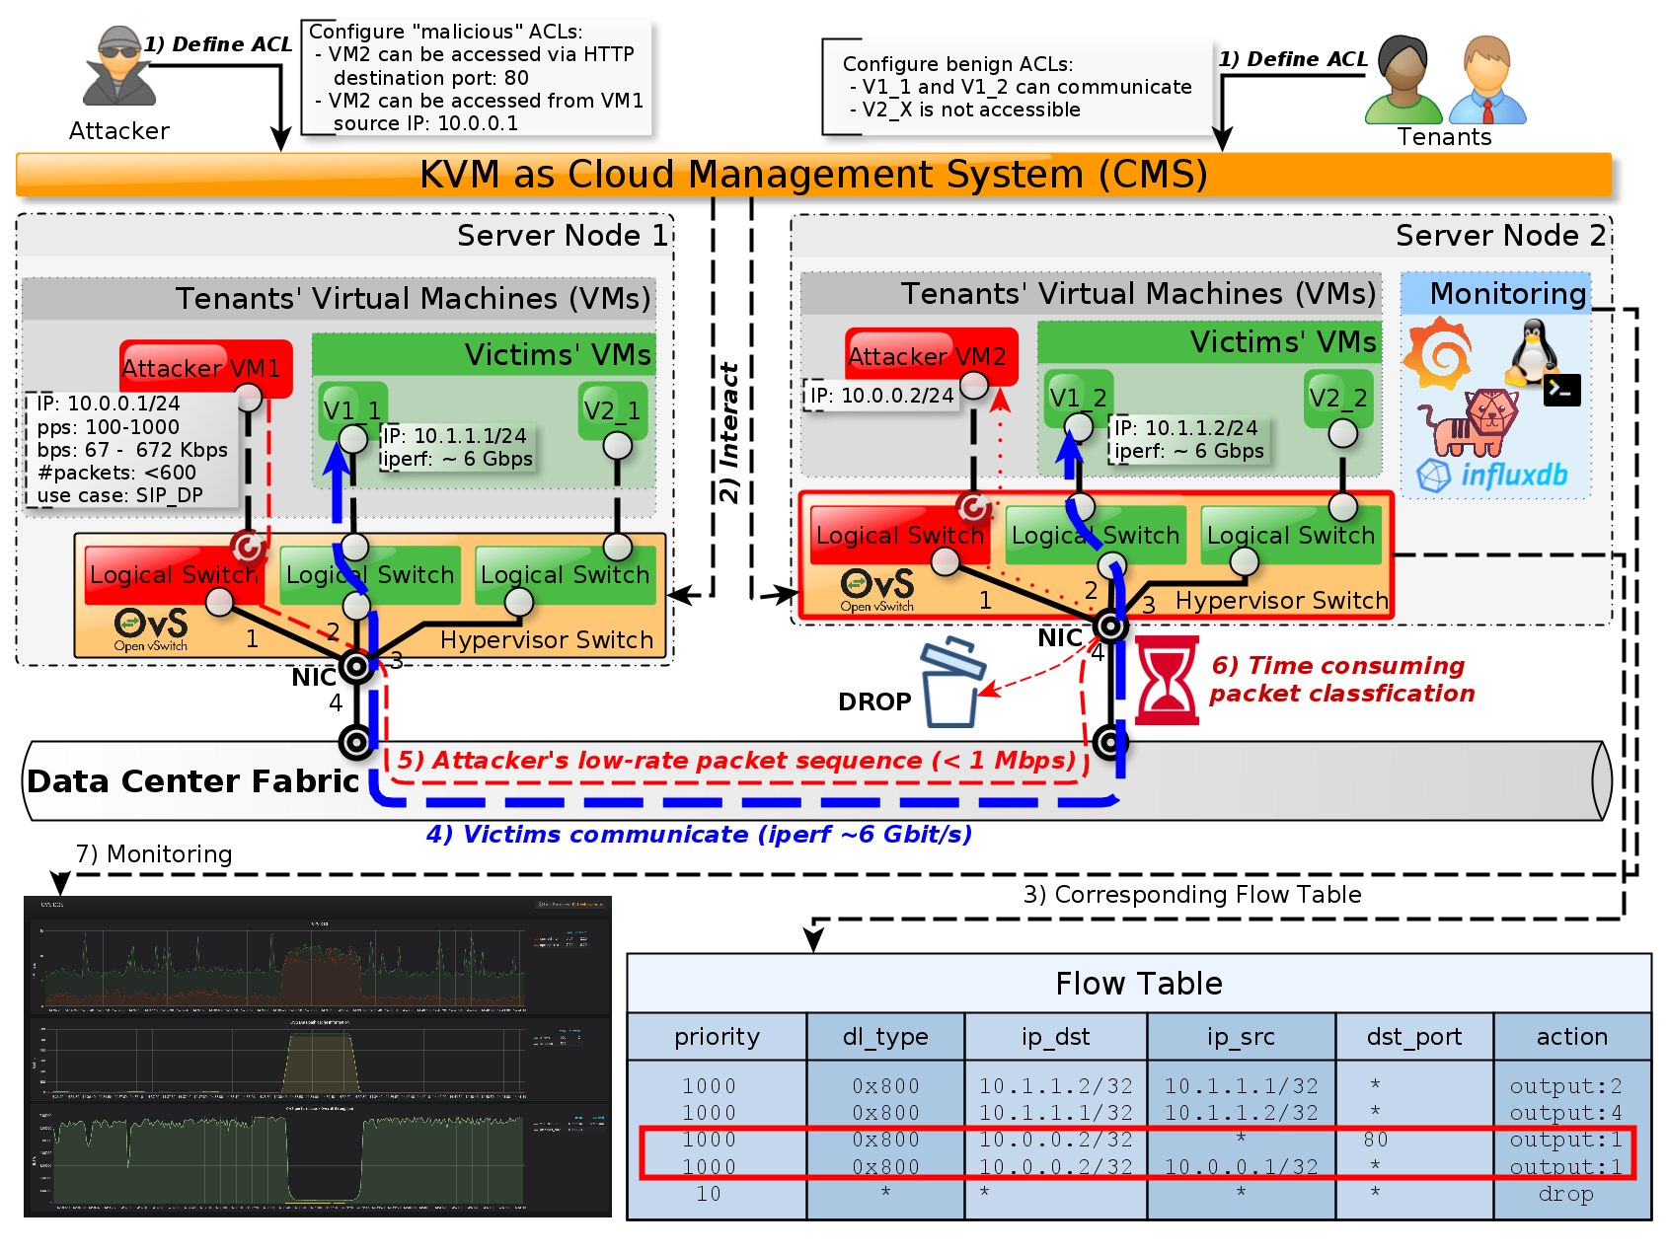
DEMO setup
Hardware
Intel(R) Xeon(R) CPU
E5-2620 v3 @ 2.40GHz
64GB RAM
Ubuntu 18.04
OVS 2.9 (latest stable release from repository)

Slide 14
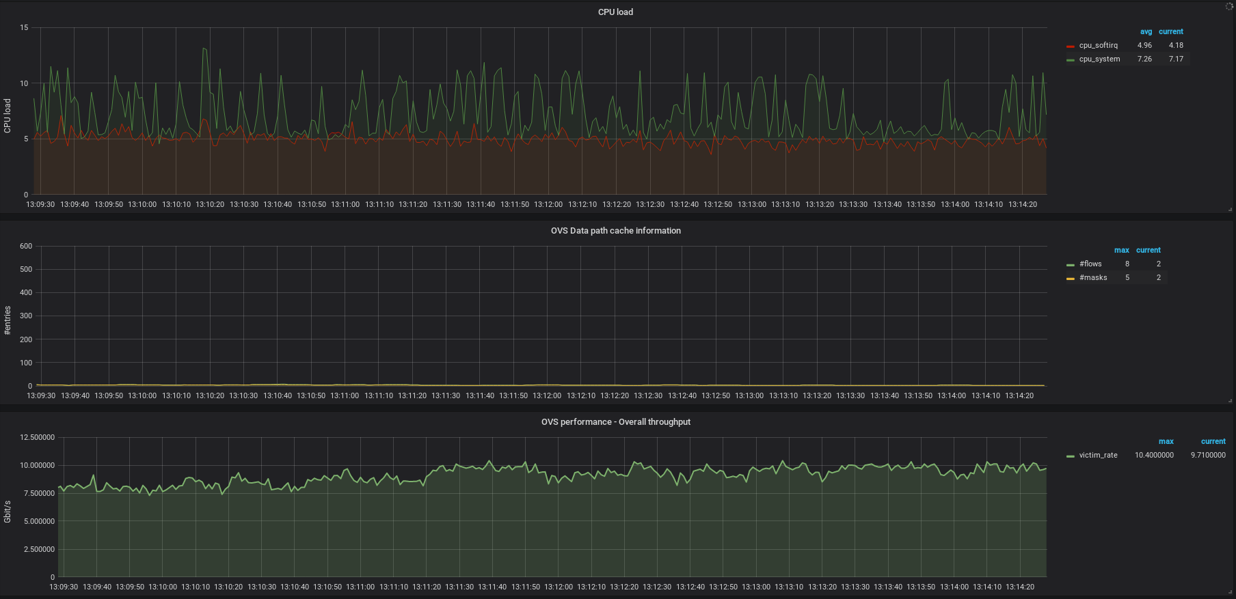
DEMO – Results/Fallback Slides
CPU load
OVS MFC
pure iperf performance

Slide 15
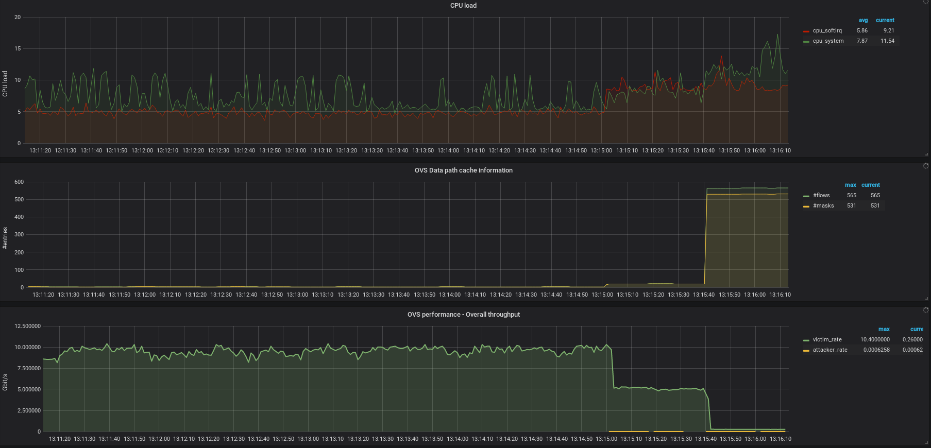
DEMO – Results/Fallback Slides
CPU load
OVS MFC
TCP DST port
+ IP SRC addr.

Slide 16
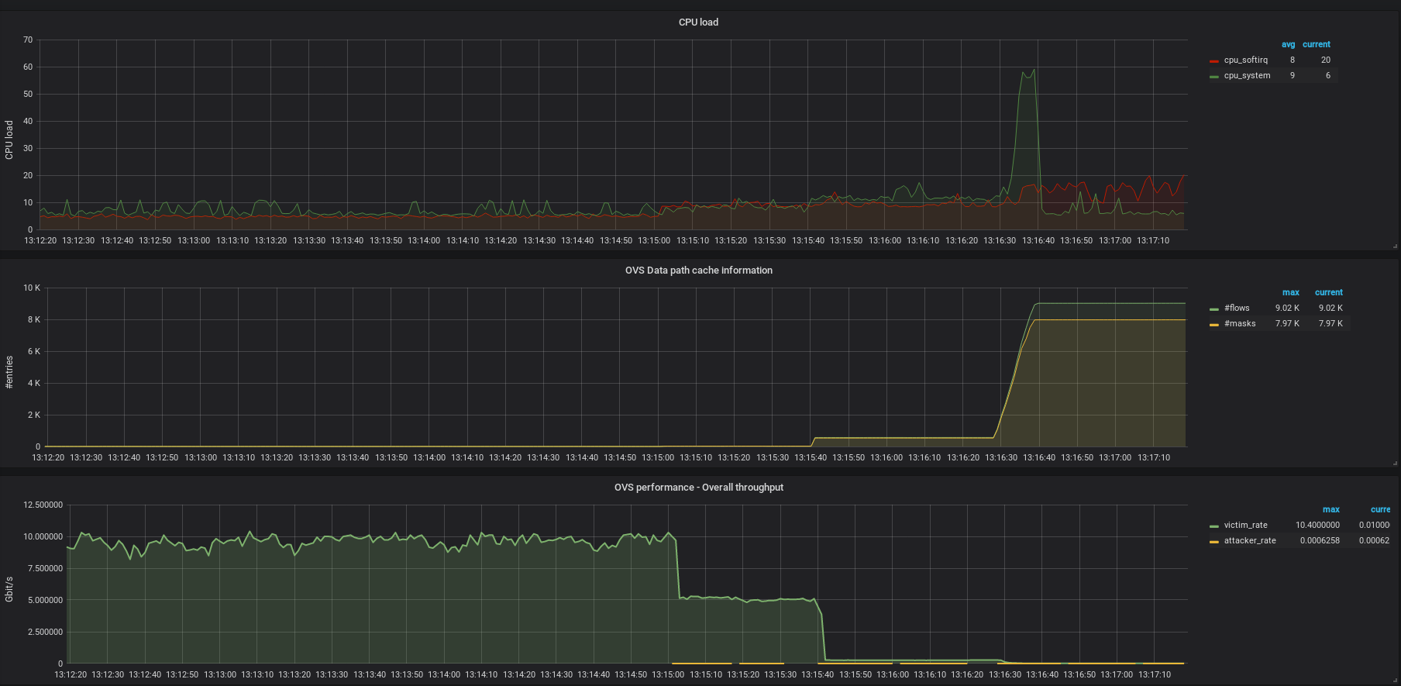
DEMO – Results/Fallback Slides
CPU load
OVS MFC
~520 ➔ ~8200
TCP DST port
+ IP SRC addr.
+ TCP SRC port

Slide 17
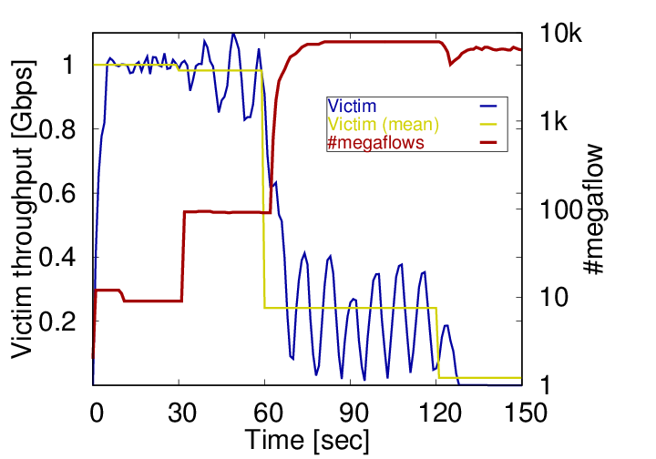
Effects in broader scale
In a cloud, an attacker can easily exploit this finding
Several public cloud deployments are affected
  Docker/OVN
  Kubernetes/OVN
  OpenStack/Neutron/OVN
Notes:
Every system where OVS is deployed is affected!
We investigated public cloud deployments to confirm our finding! And a possible attacker has everything to reproduce the attack! S/he can control the flow table, and what is more, the megaflow cache as well by defining benign ACL policies to her/his VMs and send the corresponding packet sequence against the switch!
Openstack – existing flows cannot be attacked – at 120th second victim traffic is shut off

Slide 18
Mitigation
Immediate actions to mitigate/handle the attack:
  Increase the number of CPU cores available to OVS
  Disable megaflow cache processing in OVS
  Offload ACL processing from OVS to iptables/nftables
  Offload the OVS datapath to a SmartNIC
  Use jumbo frames to drastically reduce the per-packet load
  Use our monitoring tool to spot the excess number of MFC entries
  What do you think?
Notes:
Let’s get our hands dirty, and see how the megaflow cache itself is built and managed

Slide 19
Thank You / Contact
Levente Csikor Gábor Rétvári
csikor@tmit.bme.hu retvari@tmit.bme.hu
HSN
Lab
19

Slide 20
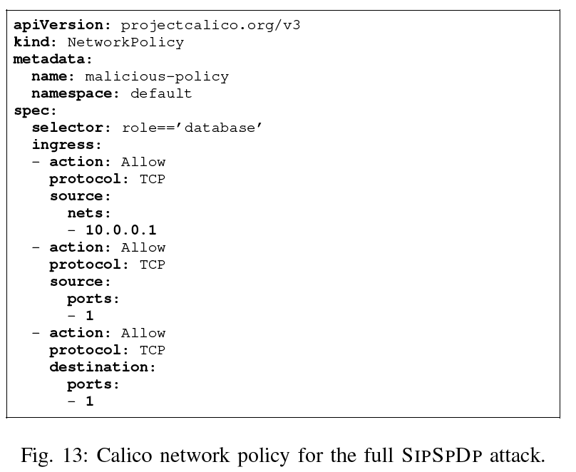
Backup (Kubernetes setup for an attack)
Notes:
Let’s get our hands dirty, and see how the megaflow cache itself is built and managed

Slide 21
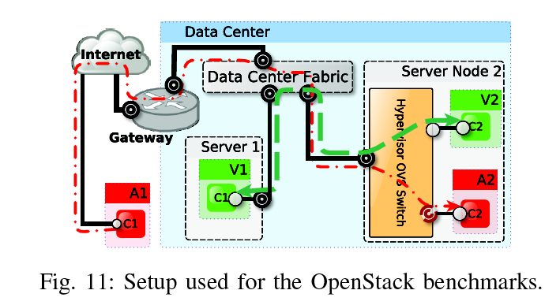
Backup (Openstack SRC IP spoofing)
Notes:
Let’s get our hands dirty, and see how the megaflow cache itself is built and managed

