Slide 1
OVSDB
“use it to configure a switch or track your stamp collection”

Slide 2
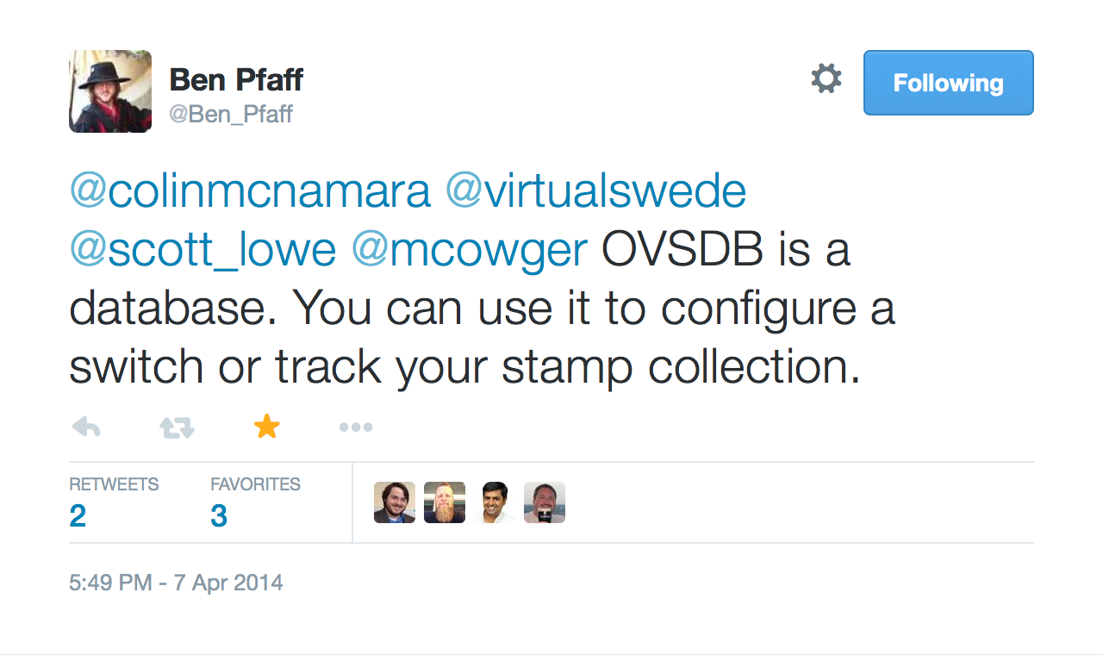

Slide 3
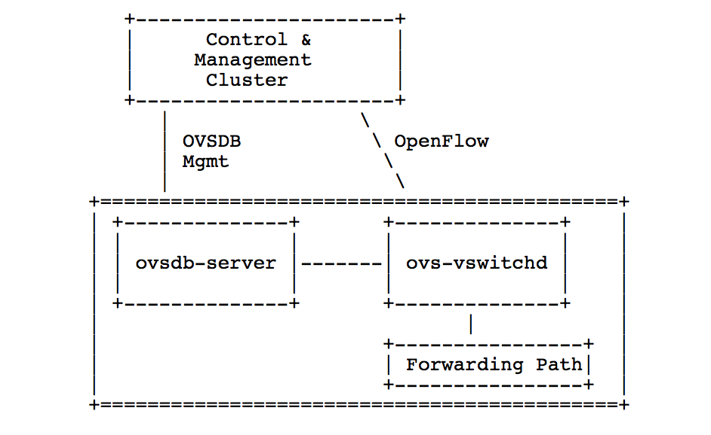

OVSDB - RFC 7047
Open vSwitch Database Management Protocol

Slide 4
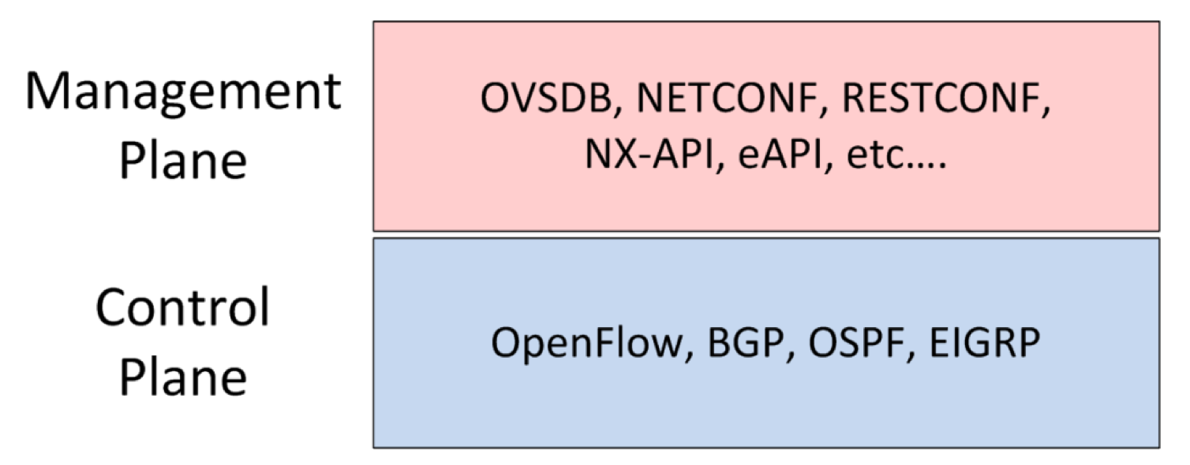
OVSDB vs Openflow

Slide 5
OVSDB
“Beautifully simple”
Bidirectional JSON-RPC
Schema based
Standard Database Operations

Slide 6
1. JSON-RPC 1.0
Request :
{
“id" : <string> or <integer>
“method" : <string>,
“params" : [<object>]
}
Response :
{
"id":<string> or <integer>
“result" : [<object>],
“error" : <error>
}
Sample “get_schema” request
{
"id": “cf3f5cd1-0690-40bb-…”
"method": “get_schema",
"params": [
"Open_vSwitch"
]
}

Slide 7
RPC methods
list_dbs
get_schema
transact
cancel
monitor
monitor_cancel
lock
steal
unlock
echo
update
locked
stolen
echo

Slide 8
2. Schema
<database-schema> :
{
“name”:<id>,
"tables": {<id>: <table-schema>, …},
…,
}
<table-schema> :
{
"columns": {<id>: <column-schema>, ...}
…,
}
<column-schema> :
{
"type": <type>
…,
}
Sample (Open_vSwitch Schema) response
{
"id": "cf3f5cd1-0690-40bb-9cfb-1a4e690b6edb",
"result": {
"name": "Open_vSwitch",
"tables": {
"Bridge": {
"columns": {
"controller": {
"type": {
"key": {
"refTable": "Controller",
"type": "uuid"
},
"max": "unlimited",
"min": 0
}
},
"datapath_id": {
"type": {
"key": "string",
}
},
…
…
}

Slide 9
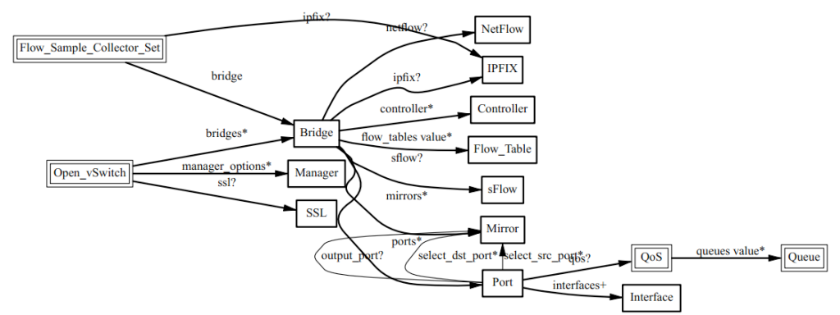
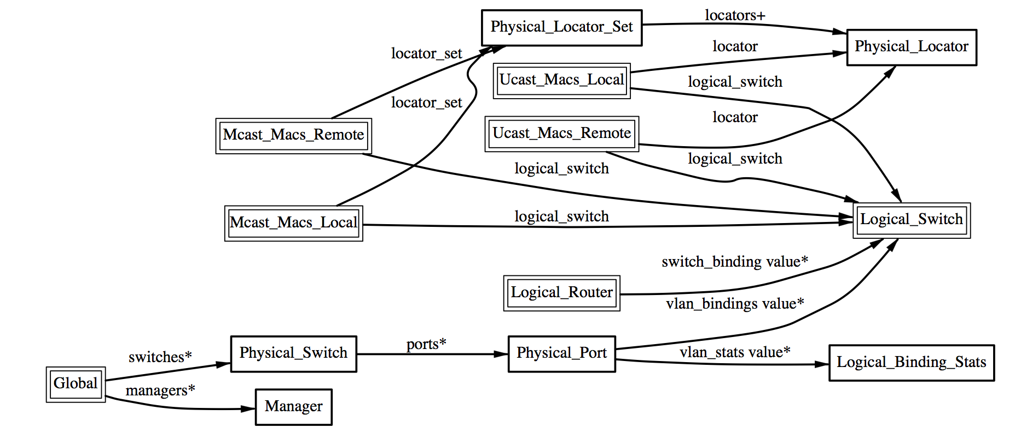
Open_vSwitch
http://openvswitch.org/ovs-vswitchd.conf.db.5.pdf
hardware_vtep
http://openvswitch.org/docs/vtep.5.pdf

Slide 10
3. Database Operations
insert
select
update
mutate
delete
wait
commit
abort
comment
assert
transact method

Slide 11
Sample transact operations
atomic, consistent & isolated
{
"id": "35ed2089-da1e-4898-80a4-b5506ab7f227",
"method": "transact",
"params": [
    “Open_vSwitch”,
  {
  "op": "update",
  "row": {
  "ports": [
  "set",
  [
  [
  "uuid",
  "55c2f8c4-257e-4a2b-ac4c-99ddfd77240c"
  ]
  ]
  },
  "table": "Bridge",
  "where": [
  [
  "_uuid",
  "==",
  [
  "uuid",
  "f14fb5aa-1578-4ca0-81c3-4bb9c1c2ba5f"
  ]
  ]
  ]
},
    {
    "mutations": [
    [
    "next_cfg",
    "+=",
    1
    ]
    ],
    "op": "mutate",
    "table": "Open_vSwitch",
    "where": [
    [
    "_uuid",
    "==",
    [
    "uuid",
    "987c42d0-eab0-43d9-a32b-4246973706c2"
    ]
    ]
    ]
    },
    {
    "comment": “Awesome comment"
    "op": "comment"
    }
    ]
}

Slide 12
What next ?
Open-Source OVSDB Client implementations
Demo : Java & Go based
https://github.com/socketplane/libovsdb
Want to develop your own Stamp collection DB ?
  git clone https://github.com/openvswitch/ovs
  refer to vswitchd/vswitch.ovsschema
  & vtep/vtep.ovsschema
  Write your own stamp collector schema and start collecting.

