Slide 1
Managing Open vSwitch Across a Large Heterogeneous Fleet
Chad Norgan
Systems Engineer
BeardyMcBeards in #openvswitch

Slide 2




About Rackspace
Global Footprint
Customers in
120+ Countries
Over $1B
Annualized Revenue
We Serve
FORTUNE®
300,000+ Customers
≅70 PB Stored
60%
100
OVER
OF
THE
5,000+ Rackers
9 Worldwide
Data Centers
Portfolio of
Hosted Solutions
Dedicated - Cloud - Hybrid

Slide 3
Rackspace’s Public Cloud
Large Fleet
Heterogenous
Several different hardware manufacturers
Several XenServer major versions (sometimes on varying kernels)
Five networking configurations
Six production public clouds
Six internal private clouds
Various non-production environments
Tens of thousands of hypervisors
Hundreds of thousands of
virtual machines
1 - 3+ Interfaces
Notes:
Worth mentioning the # of kernel versions?

Slide 4
Networks Available to Customers
IPv4 & IPv6 Publicly Accessible Network
Bandwidth Metered
DC-Routable IPv4 IP
Access Other Rackspace Products
Unmetered Bandwidth
NSX L2 Overlay Network
Extendable to dedicated hardware via NSX Gateways
Cloud Networks
Service Net
Public Net

Slide 5
Our History With OVS
Rackspace has used Open vSwitch since the 0.9 version
Behind most of First Generation Cloud Servers (Slicehost)
Powers 100% of Next Generation Cloud Servers
Upgraded OVS nine times since the launch of Next Gen Public Cloud in August 2012

Slide 6
Why We Use OVS
Service provider features:
  Overlay Networks
  QoS
  VLAN Tagging
  Port Security
  LACP
Software = Flexible
Upgrades are easier than hardware

Slide 7
Our Favorite Improvements
OVS 1.7
OVS 1.9
OVS 1.10
OVS 1.11
OVS 2.0
OVS 2.1
Save & restore datapath flows during kmod reload
Logging removed from main loop, faster flow setups
Collapsed data path & flow-eviction-threshold raised to 2500
Megaflows & wildcarding
Multi-treading!
flow-limit replaces flow-eviction-threshold & TCP flags

Slide 8
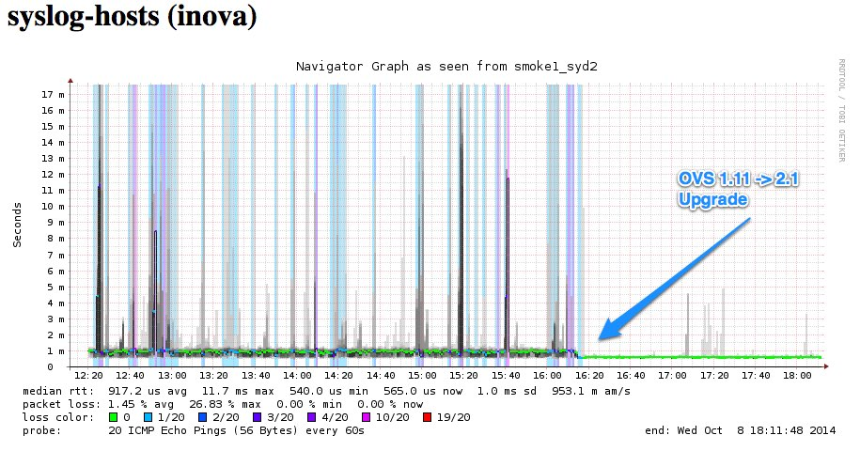
Example: Busy HV With Syslog Collector

Slide 9

Mission Accomplished!
We moved the bottleneck!
New bottlenecks:
Guest OS kernel configuration
Xen Netback/Netfront Driver

Slide 10
Challenges of Upgrading OVS
Matching the OVS kernel module to both the running and staged kernel
    Hypervisor updates often come with a newer kernel
    We often don’t immediately reboot
    Running kernel != Kernel at next reboot
    Detect both kernels and install both sets of OVS kernel modules
Heterogeneous Scale

Slide 11

OVS Upgrade Solution
Playbook-style upgrades
Asynchronous plays with parallel limits
Extensible
Easy to build validations and pre-checks to prevent unwanted impact
Notes:
We would not be able to achieve the velocity of improvements at our scale without it. It allows us to make very complex changes with confidence.

Slide 12
Architectural Basics
VIF
Integration Bridge
Tunnel Encapsulation
PIF
VIF
Interface Bridge
Patch Port
PIF
VIF

Slide 13
Ansible + OVS = Flexible Network Rewiring
VIF
Interface Bridge
PIF
Patch Port
Integration Bridge
VIF
Tunnel Encap
PIF
VIF

Slide 14
Ansible + OVS = Flexible Network Rewiring
VIF
Public Net
Bridge
Patch Port
Interface Bridge
PIF
VIF
Patch Port
Integration Bridge
VIF
Tunnel Encap
PIF

Slide 15
Ansible + OVS = Flexible Network Rewiring
VIF
Public Net
Bridge
Patch Port
Interface Bridge
PIF
VIF
Patch Port
Integration Bridge
VIF
Tunnel Encap
PIF

Slide 16
Ansible + OVS = Flexible Network Rewiring
VIF
Public Net
Bridge
Patch Port
Interface Bridge
PIF
Service Net Bridge
Patch Port
VIF
Integration Bridge
VIF
Tunnel Encap

Slide 17
Ansible + OVS = Flexible Network Rewiring
VIF
Public Net
Bridge
Patch Port
Interface Bridge
PIF
Service Net Bridge
Patch Port
VIF
Cloud Net Bridge
Integration Bridge
VIF
Tunnel Encap
Patch Port

Slide 18
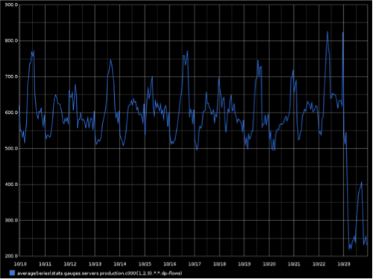

Slide 19
Ansible + OVS = Flexible Network Rewiring
Public Net
Bridge
Patch Port
Interface Bridge
Public Net Bridge
VIF
Public Net Bridge_old
PIF
Patch Port

Slide 20
Measuring OVS – PavlOVS.py
Publishes metrics to StatsD/Graphite
Per bridge byte, packet, open flow count
Datapath hit, missed, lost, flow counts
Open vSwitch CPU utilization
Instance count
Tunnels configured and in fault state

Slide 21
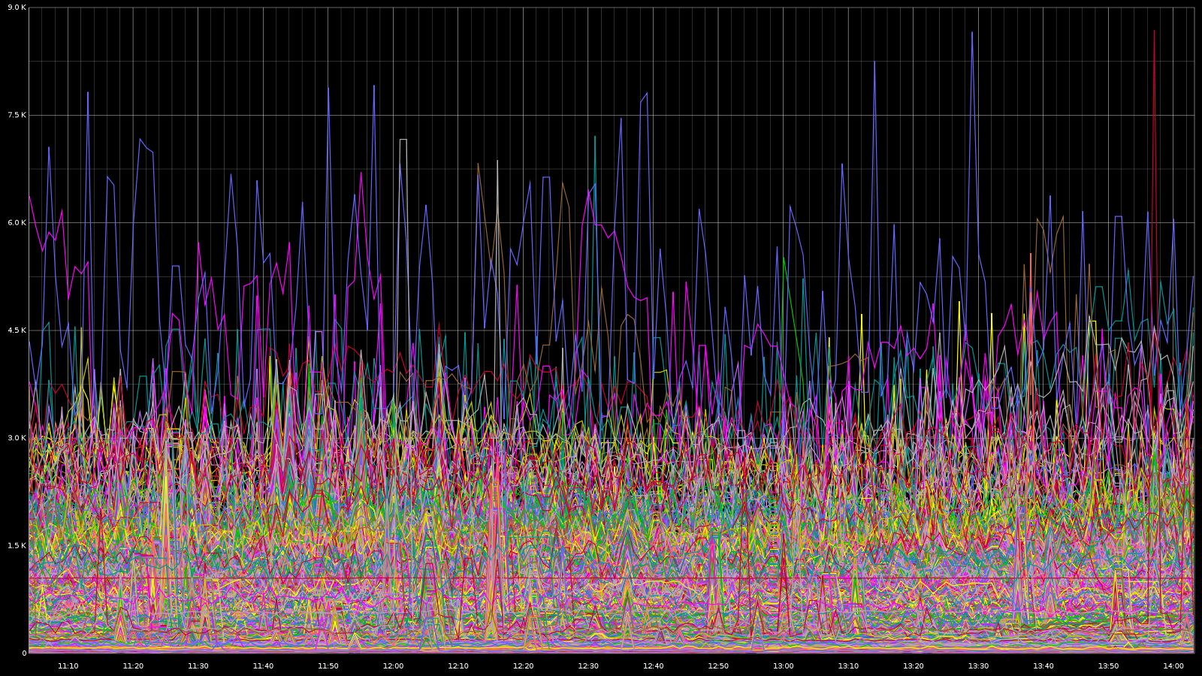
Datapath Flow Count
2000 Eviction Threshold

Slide 22
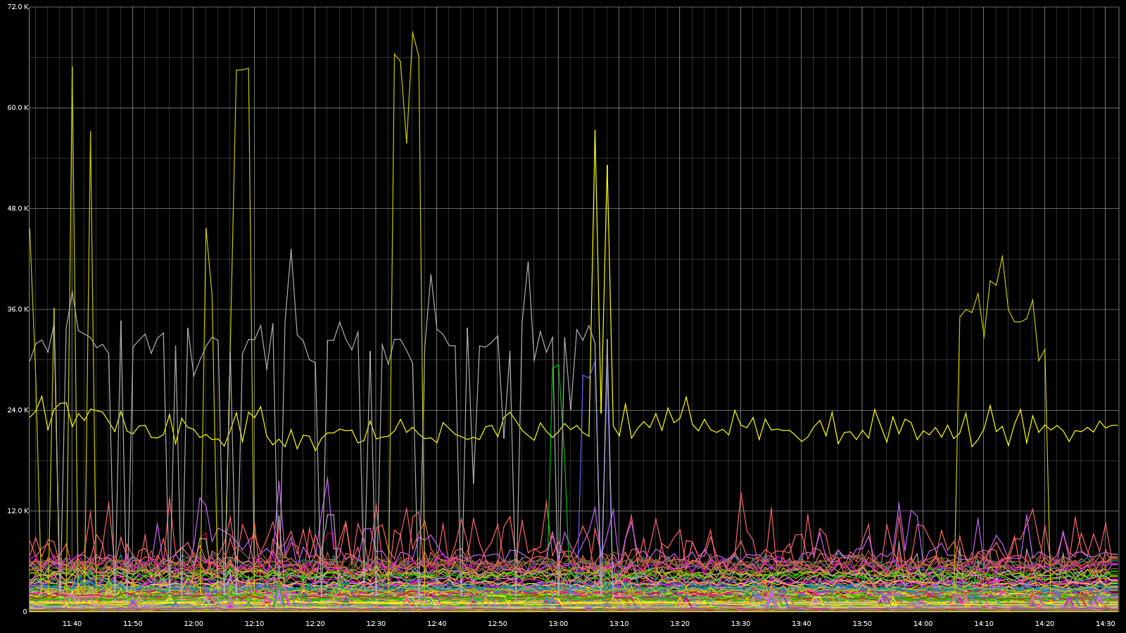
Datapath Flow Count

Slide 23
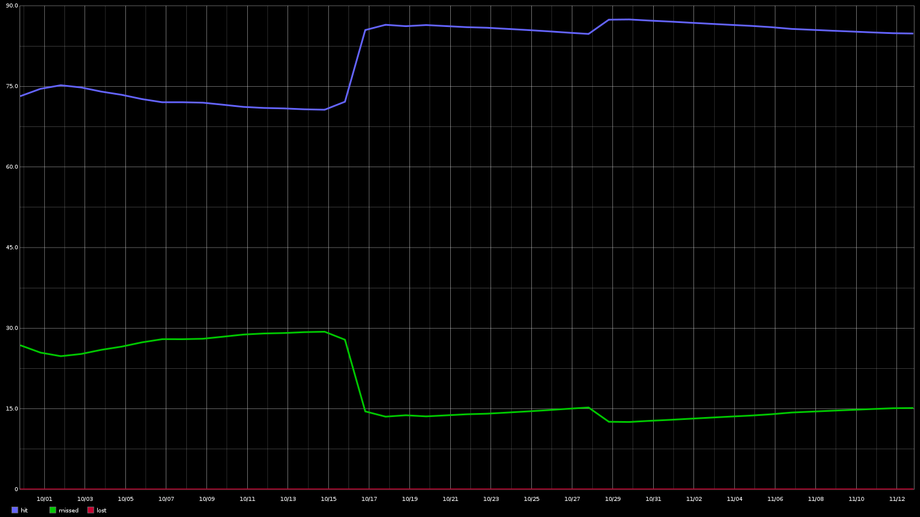
Hit, Miss, Lost
Hit, Miss, Lost

Slide 24
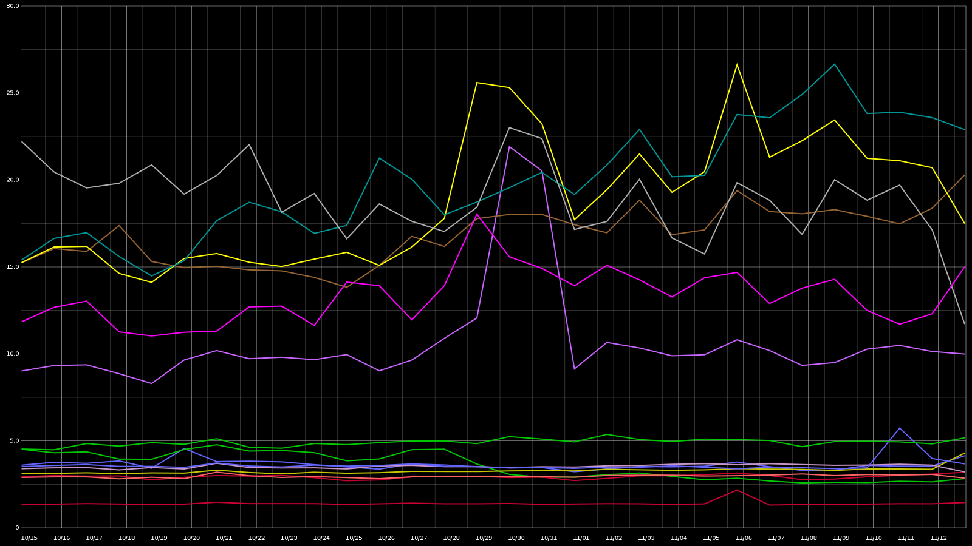
OVS CPU
OVS CPU By Cell

Slide 25
The OVS Of Our Dreams
Connection Tracking
More (efficient) performance
JSON Output from ovs-*ctl commands

Slide 27
QUESTIONS?

